Slide 1
DevOps Project Deploying a web Application with jenkins CI/CD, Docker

Slide 2

Introduction to Jenkins
Jenkins is a powerful, open-source automation server that helps streamline software development processes
by automating tasks related to building, testing, and deploying applications. It is widely used in DevOps to
enable Continuous Integration (CI) and Continuous Delivery (CD), ensuring faster, more reliable software releases.
Automates repetitive tasks like builds, tests, and deployments.
Reduces manual errors by ensuring consistency in build processes.
Detects code issues early with Continuous Integration.
Speeds up software delivery through Continuous Delivery pipelines.
Integrates with multiple tools such as Docker, SonarQube, Kubernetes, etc.
Continuous Integration: Automatically build and test code changes to detect errors early.
Continuous Delivery: Automate the deployment of applications to different environments.
Automated Testing: Run unit tests, integration tests, and performance tests.
Build Automation: Compile, package, and deliver artifacts using tools like
Maven, Gradle, and Ant.
Containerization and Deployment: Build Docker images and deploy them to
cloud environments or orchestration platforms.

Slide 3
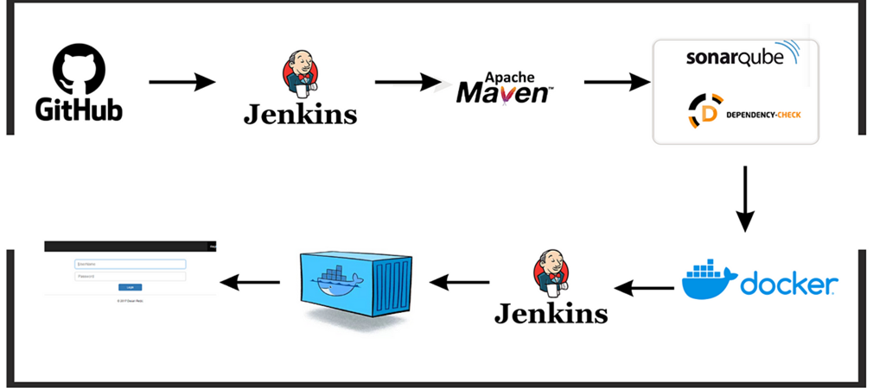
Tools & Technologies Used
Jenkins – CI/CD pipeline automation
Git & GitHub – Version control
Maven – Build automation
Docker – Containerization
AWS EC2 (or any server) – Hosting
SonarQube – Code quality analysis

Slide 4
Life cycle of CI/CD Pipeline for Petshop Java-Based Application Deployment​
Overview:
This project demonstrates the deployment of a web application using Jenkins CI/CD pipeline integrated with Docker.
Automates the build, test, and deployment process.
Objective:
Implement Continuous Integration and Continuous Deployment (CI/CD).
Utilize Docker for containerization.
Ensure seamless deployment and scalability.

Slide 5
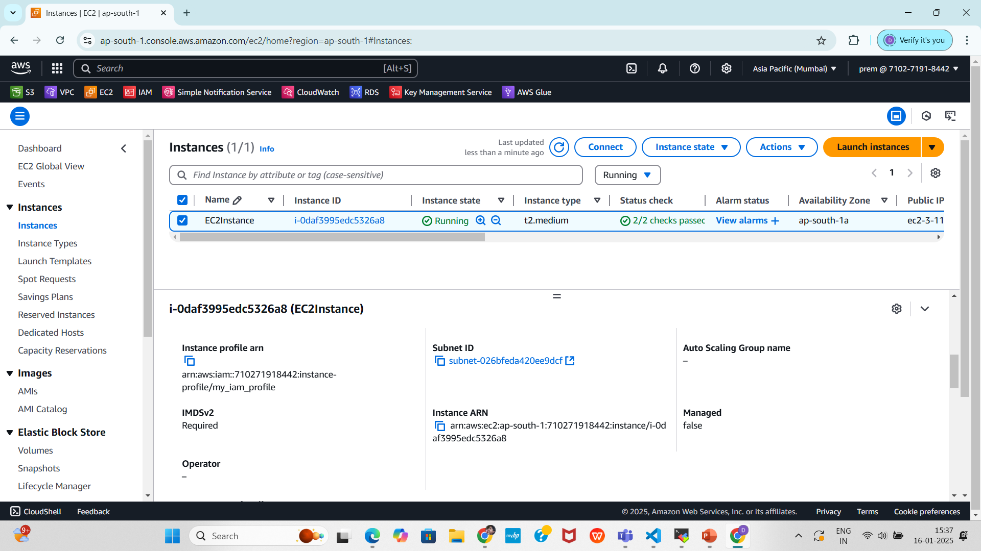
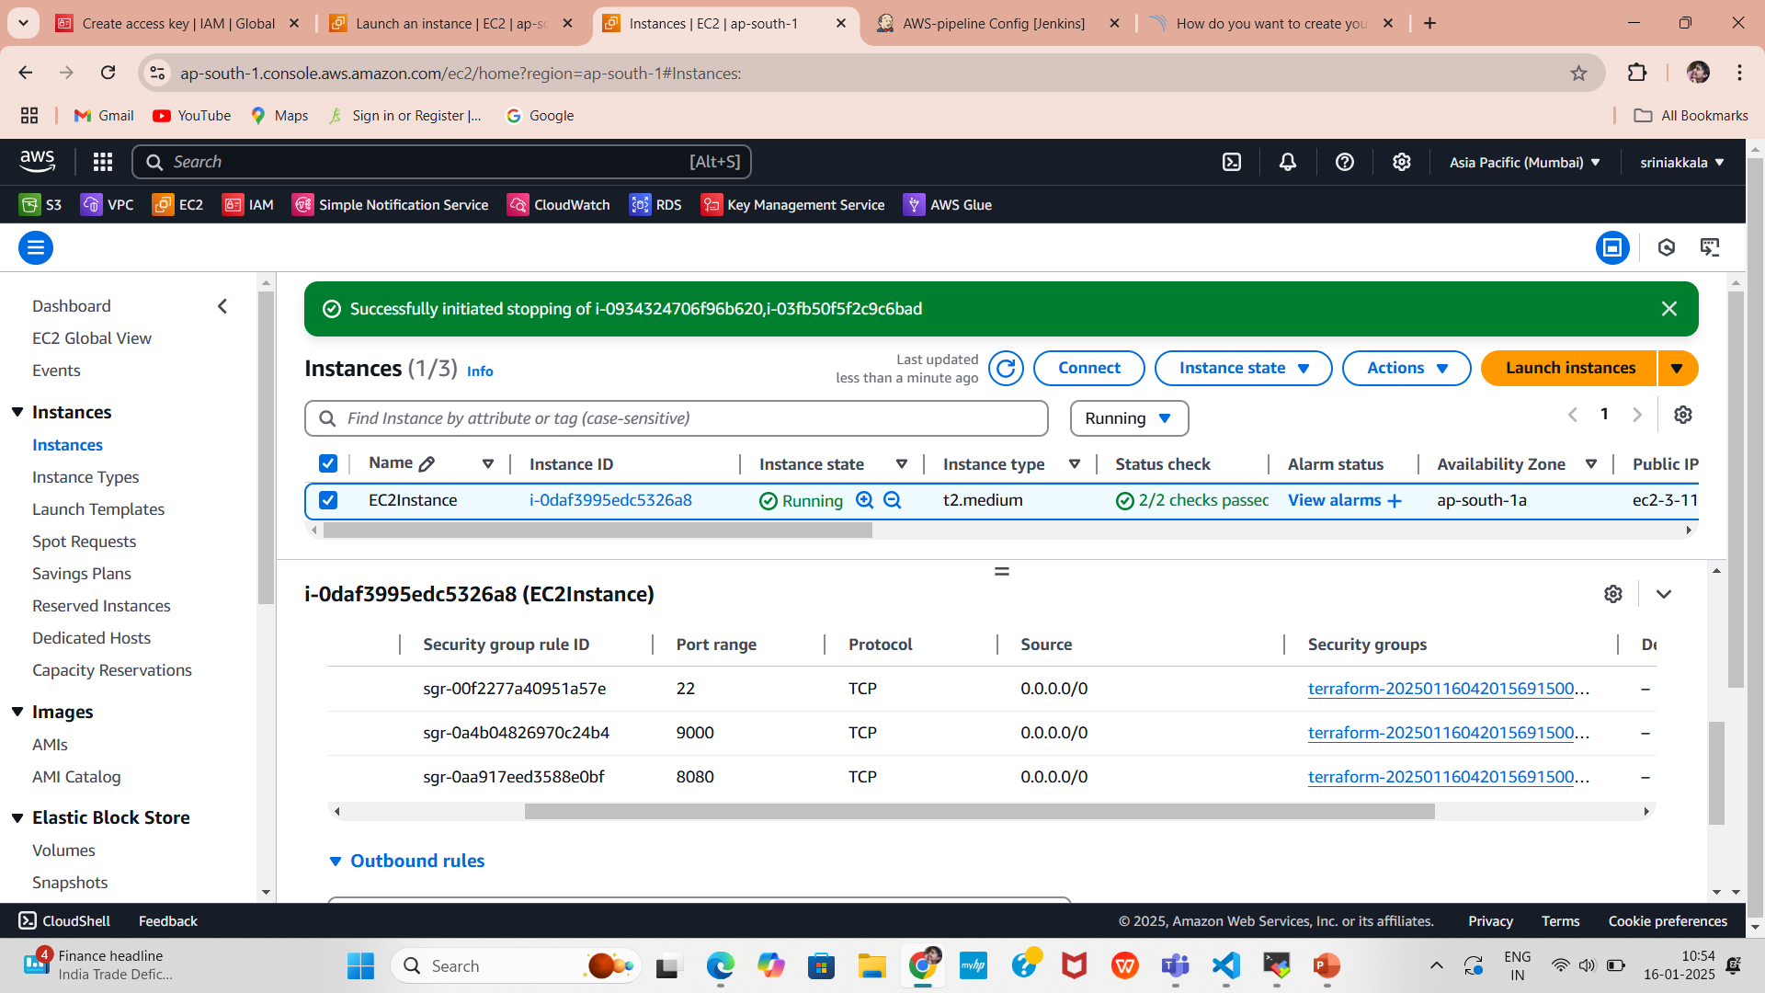
1.Create EC2 Instance
1.1.EC2 Dashboard:
Go to Services > EC2.
1.2.Create Instances:
Create the EC2 instance is running under the Instances
section.
Confirm the instance details:
AMI: Ubuntu 20.04 (ami-053b12d3152c0cc71).
Instance Type: t2.large
Subnet: Default subnet in ap-south-1a.
1.3. Security Group:
Go to the Security Groups section.
Verify the ec2_sg group is created with the following rules:
Inbound: Ports 22 (SSH), 8080 (HTTP), 9000 (SonarQube).
Outbound: All traffic allowed.

Slide 6
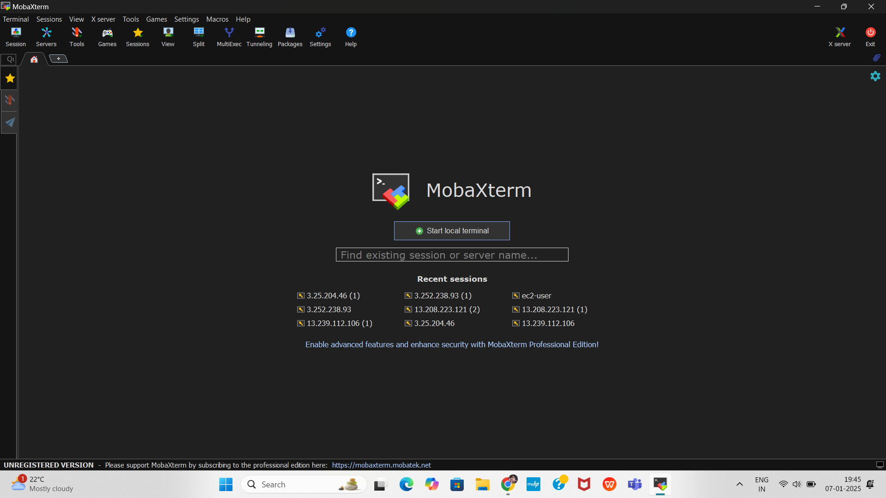
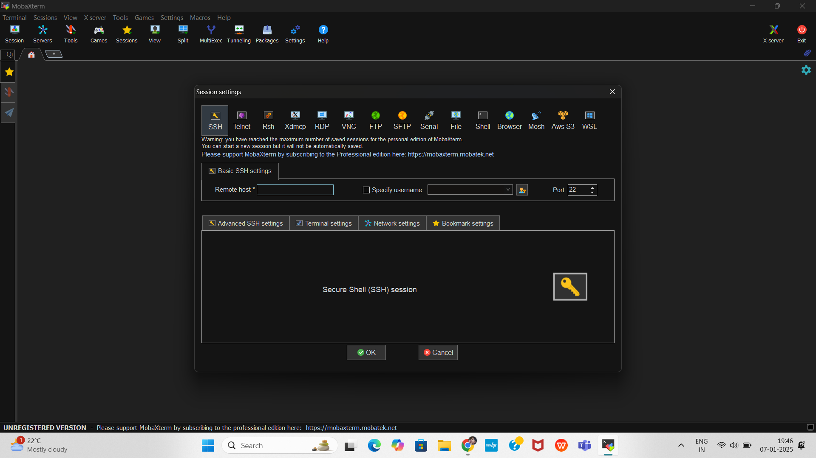
Connect to the EC2 Instance using MobaXterm
Here we can use MobaXterm, a popular SSH client, to connect to your AWS EC2 instance from your local system
Create a New SSH Session
In the MobaXterm home screen, click on Session in the top-left menu.
In the Session Settings, click SSH.
Enter the EC2 Instance Details
In the Remote Host field, enter your EC2 instance’s Public IP Address(3.145.148.24).
Ensure the Port is set to 22 (default SSH port).
Enter specify username (ubuntu) .

Slide 7
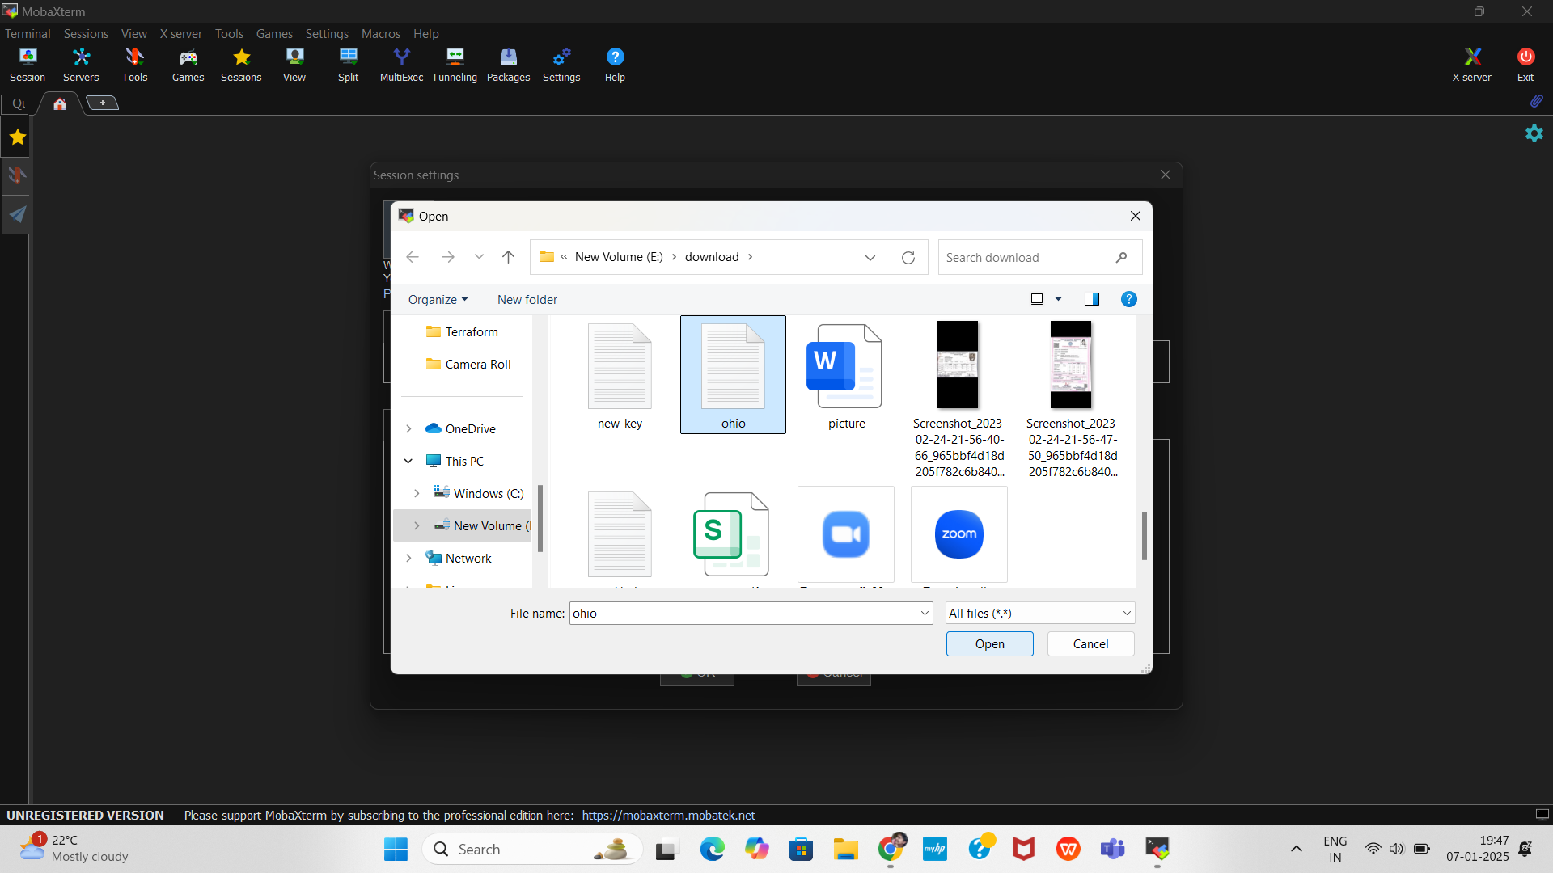
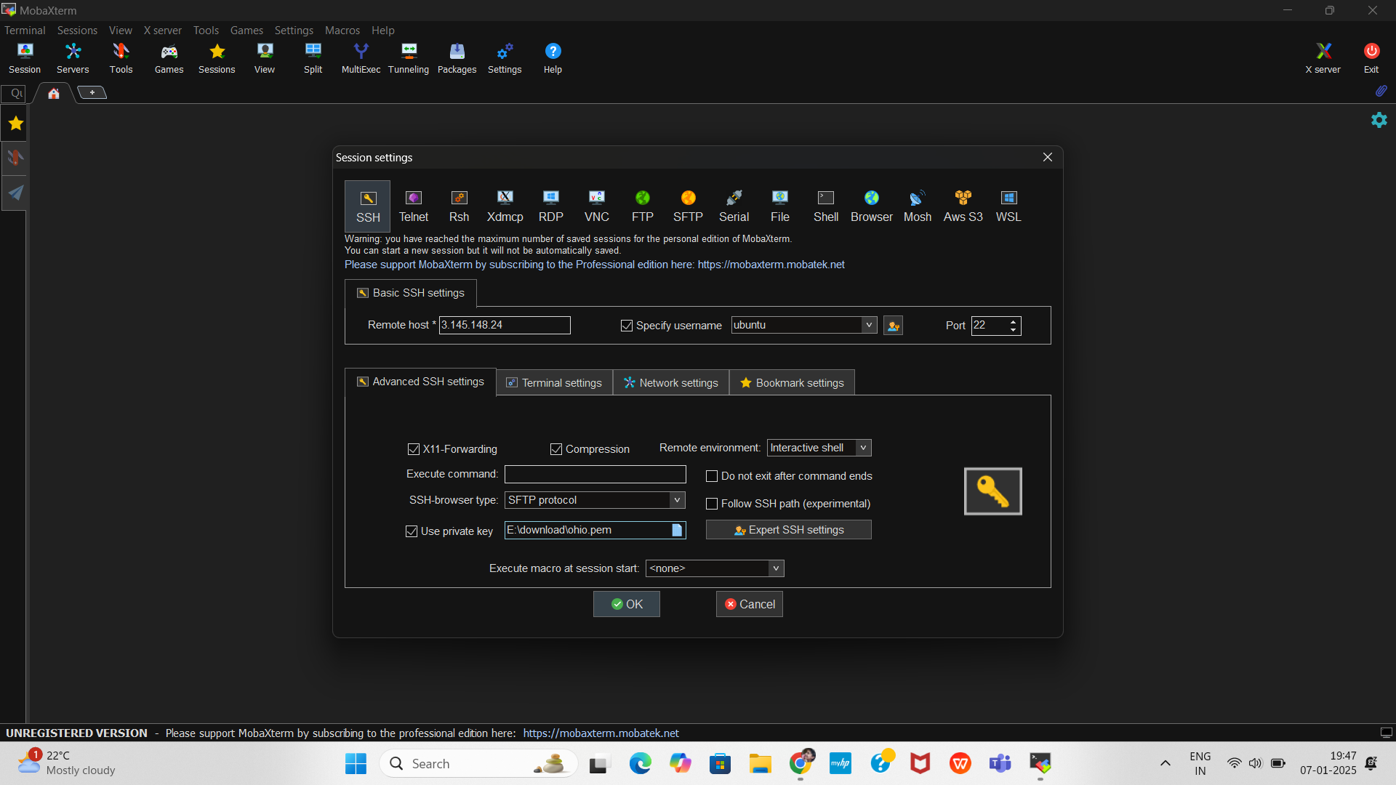
Configure the Private Key (PEM File)
In the SSH Session Settings, click on Advanced SSH Settings.
Under Use private key, click Browse and select your new-key.pem file (downloaded from AWS).
Click OK to save the settings.

Slide 8
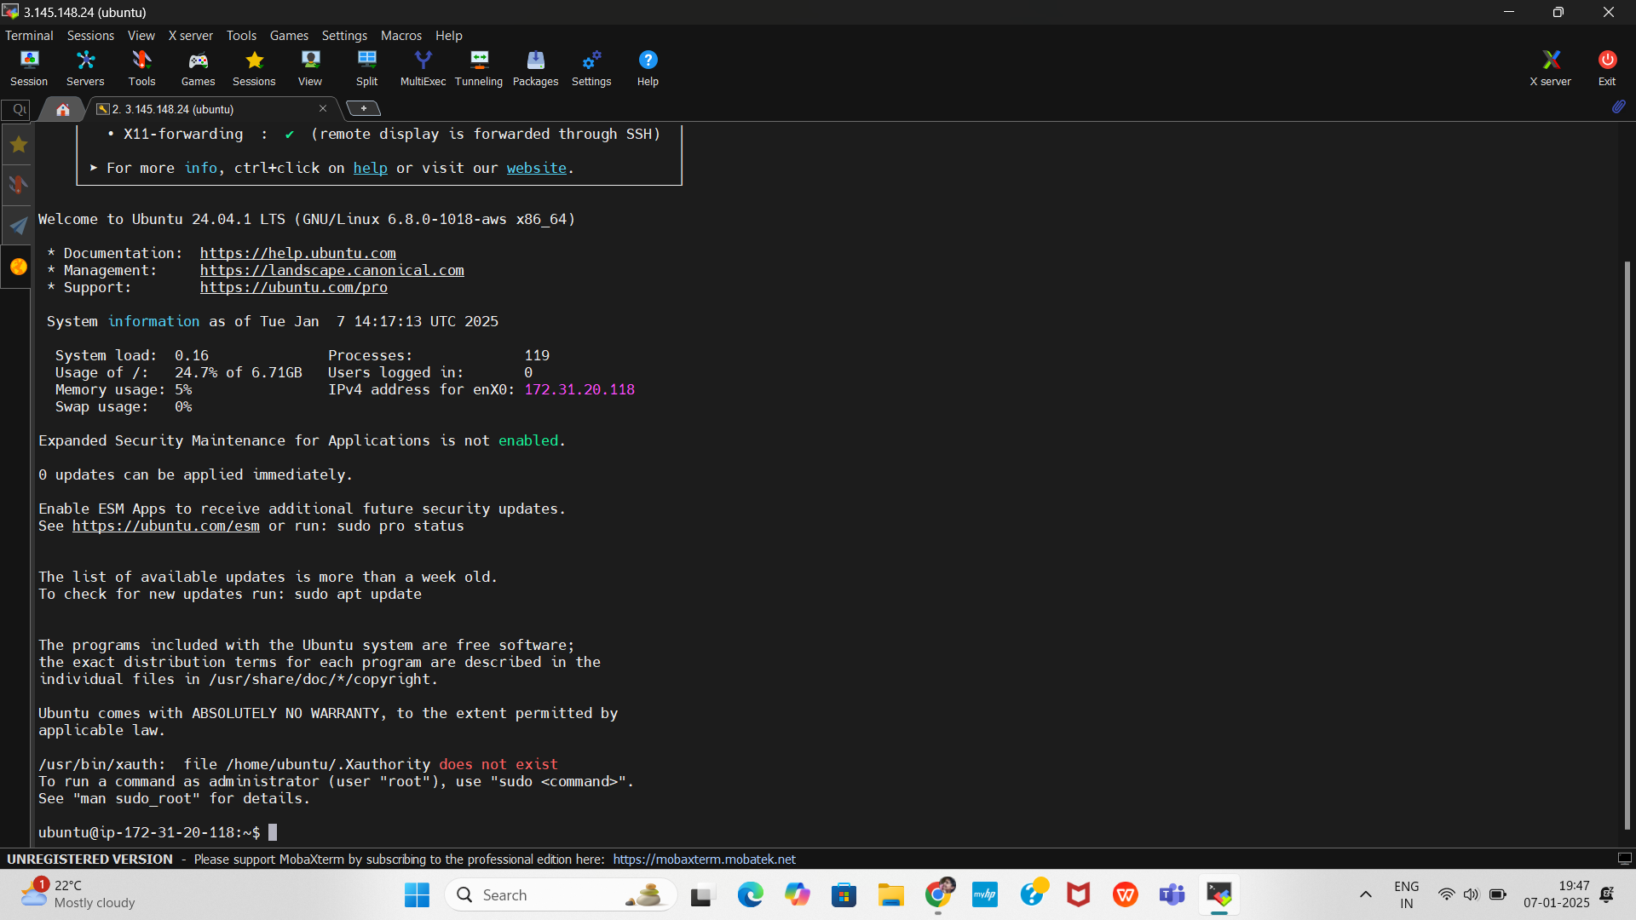
Login to the EC2 Instance
You are now connected to your EC2 instance via MobaXterm.

Slide 9
Install Jenkins on the EC2 Instance
After connecting to your EC2 instance using MobaXterm follow the steps below to install Jenkins on Ubuntu.
Update the System Packages
Before installing any software, update the existing packages:
sudo apt update
sudo apt upgrade -y
Install Java
Jenkins requires Java to run. Install OpenJDK 17 with the following command
After the installation, verify the Java version.
Sudo apt update
Sudo apt install fontconfig openjdk-17-jre
Java -version

Slide 10
Add the Jenkins Repository
Add the Jenkins repository to your system’s source list.
sudo wget -O /usr/share/keyrings/jenkins-keyring.asc \
https://pkg.jenkins.io/debian-stable/jenkins.io-2023.key
echo deb [signed-by=/usr/share/keyrings/jenkins-keyring.asc] \
https://pkg.jenkins.io/debian-stable binary/ | sudo tee \
/etc/apt/sources.list.d/jenkins.list > /dev/null
Run the following commands to update the package list and install Jenkins.
sudo apt-get update
sudo apt-get install jenkins

Slide 11
Start and Enable Jenkins Service
1. Start the Jenkins Service
Explanation: This command starts the Jenkins service immediately. If Jenkins is installed correctly, this command will initialize and run Jenkins.
2. Enable Jenkins to Start Automatically on System Boot
Explanation: This command configures Jenkins to start automatically whenever the system reboots. It creates symbolic links to the Jenkins service configuration in system boot directories.
3. Verify the Jenkins Service Status
Explanation: This command checks whether the Jenkins service is running. It displays information such as:
The current status (active (running), inactive, or failed).
Start time and uptime.
Expected Output: If Jenkins is running successfully, you should see) Active (running) in the status output.
sudo systemctl start jenkins
Sudo systemctl enable jenkins
sudo systemctl status jenkins

Slide 12
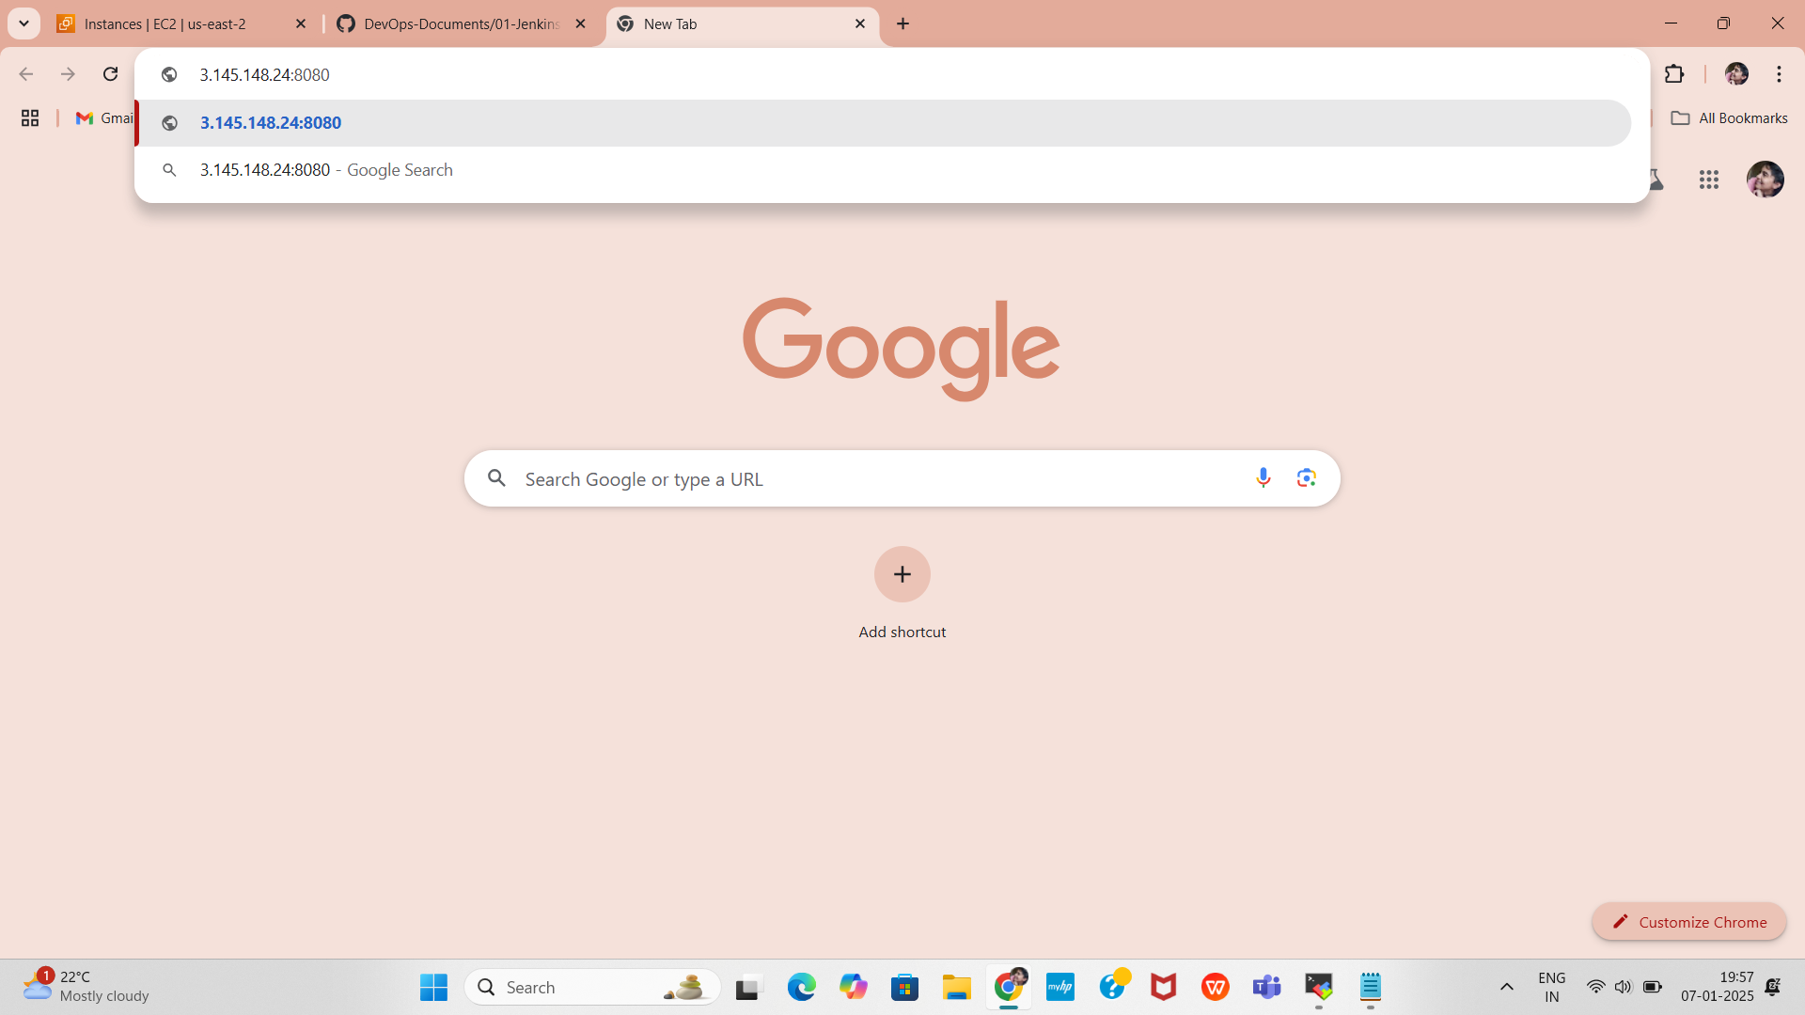
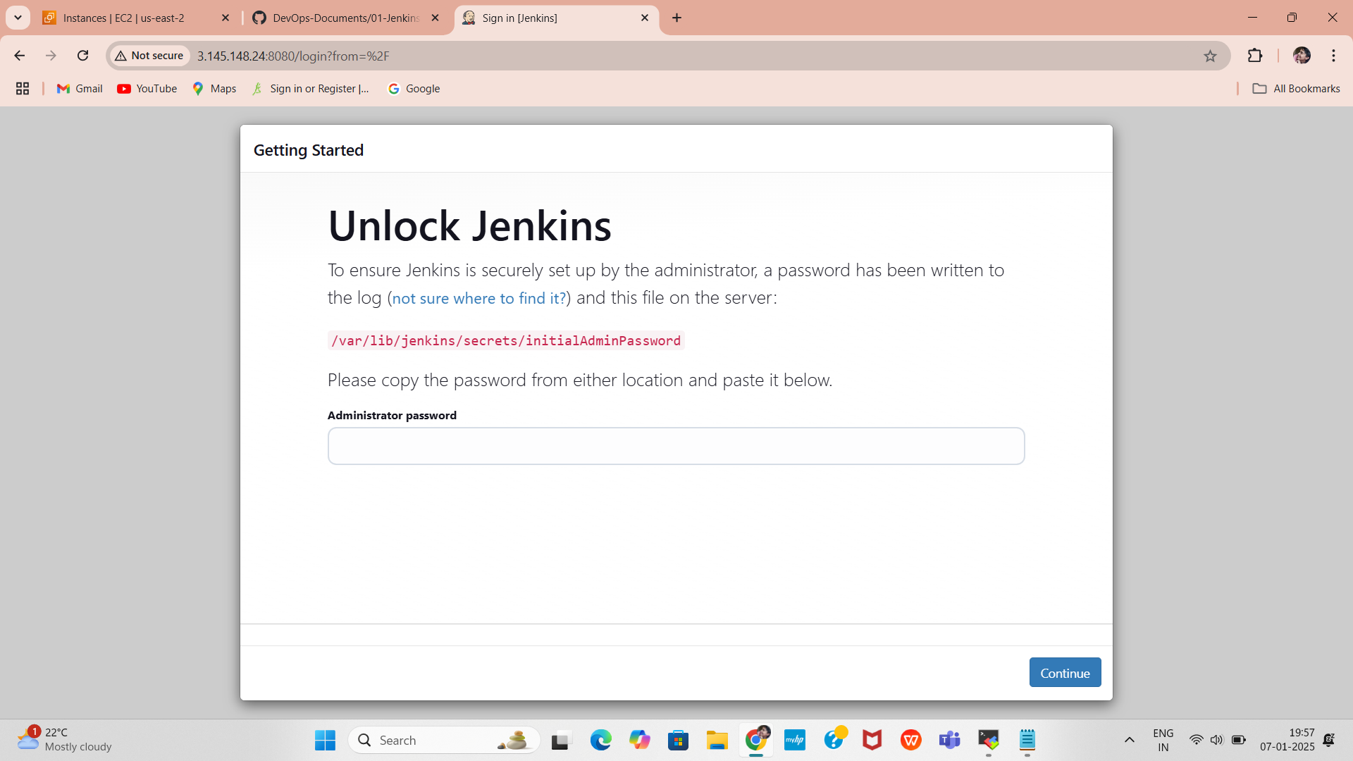
Open Web Chrome Port 8080
Jenkins runs on port 8080 by default. Ensure that port 8080 is open in your security group and allow it through the Ubuntu firewall.
Access Jenkins Web Interface
Open your browser and go to http://3.145.148.24:8080
You will see the Jenkins Unlock Screen.

Slide 13
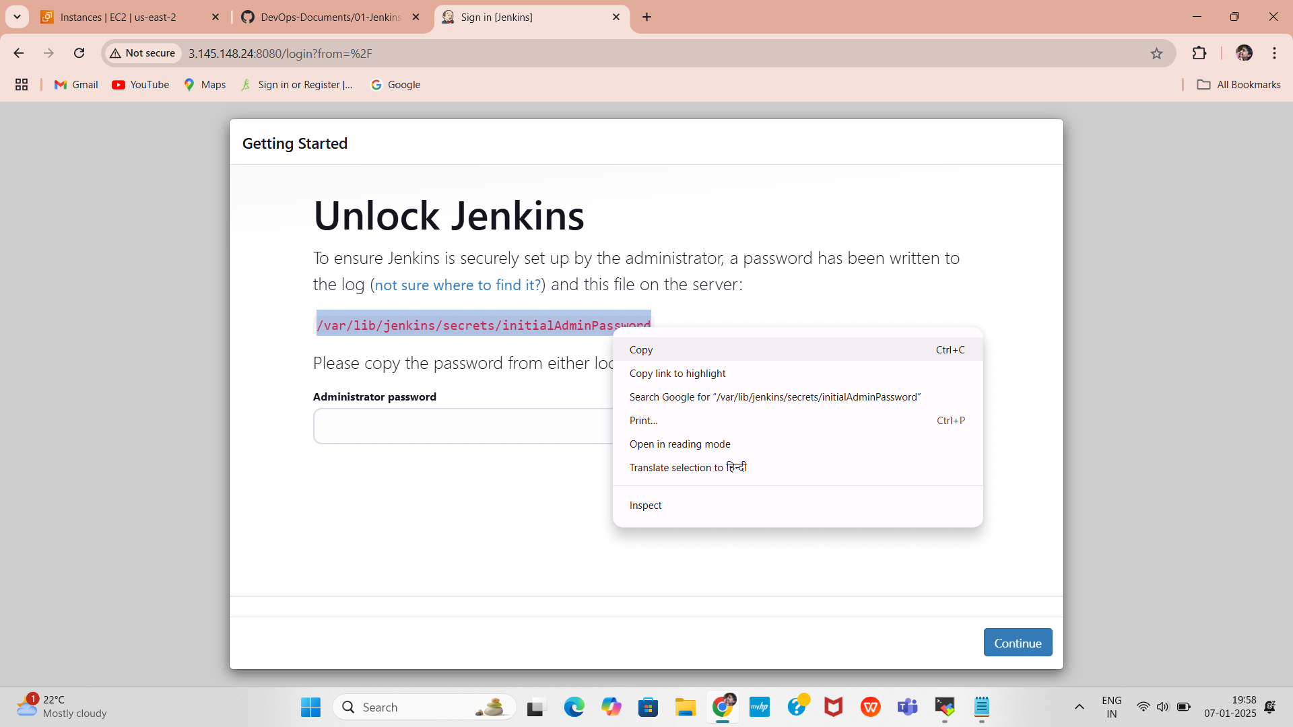
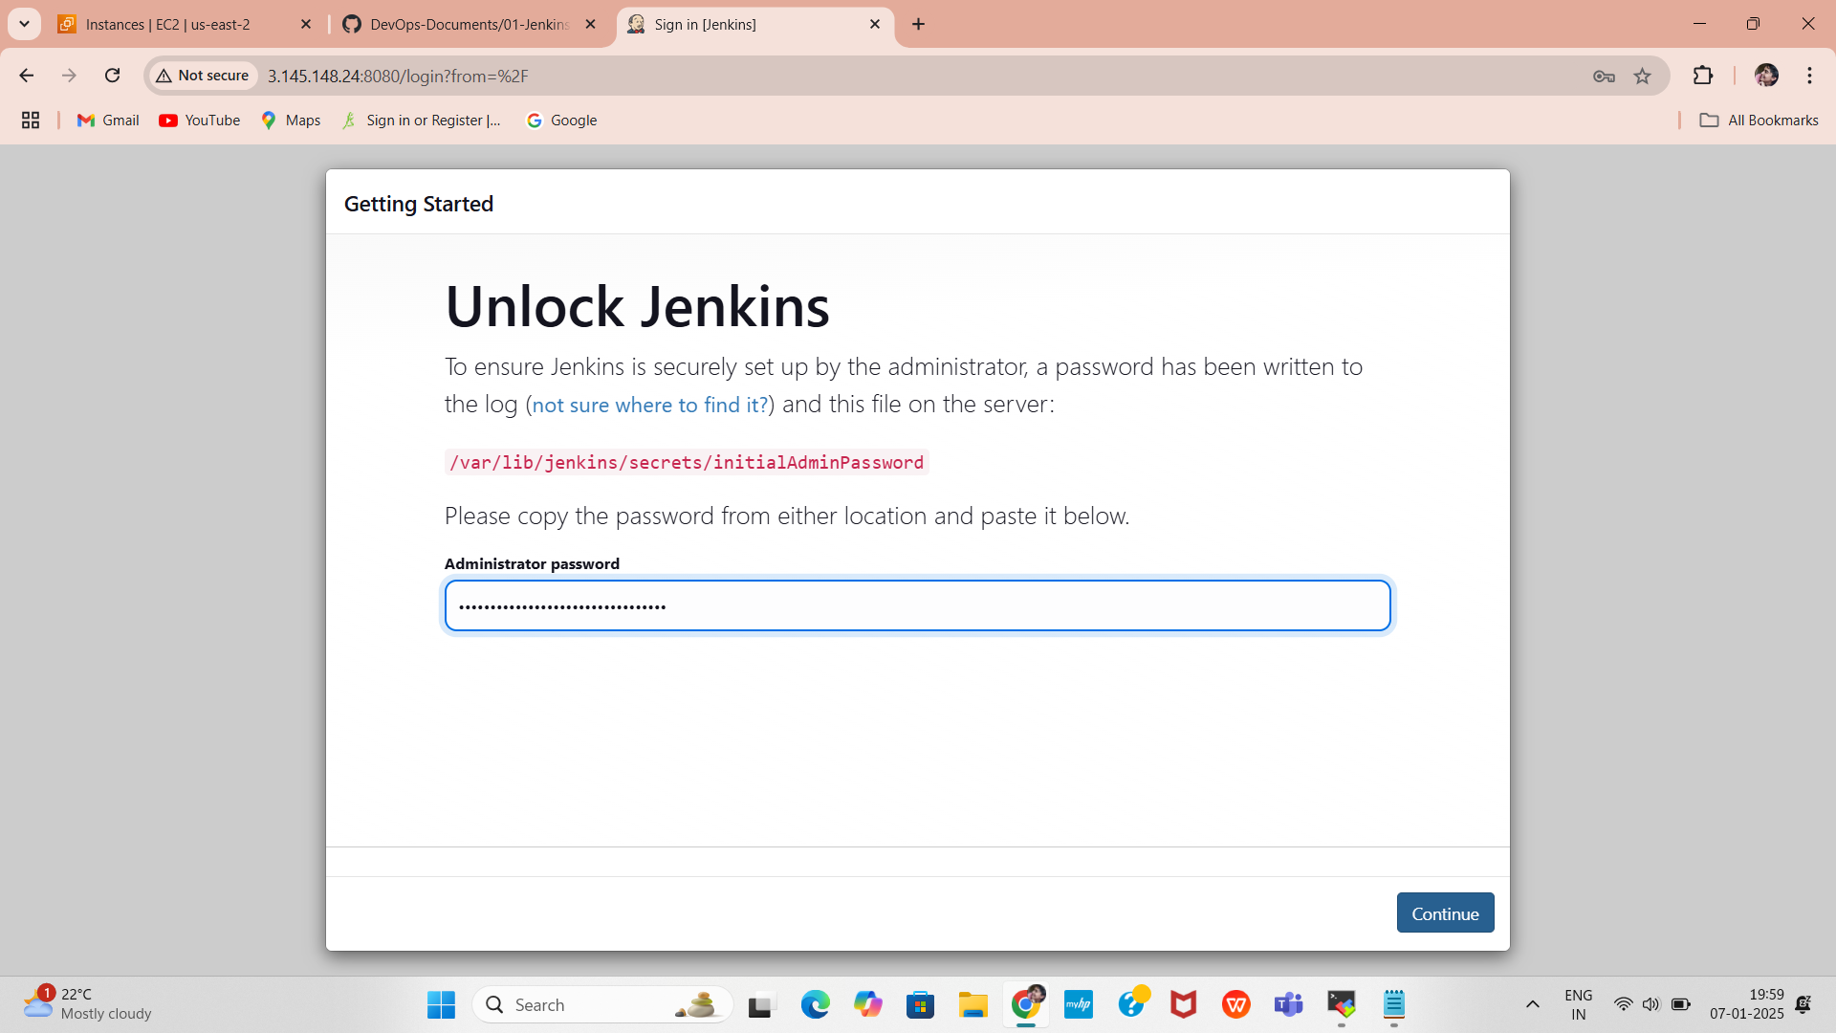
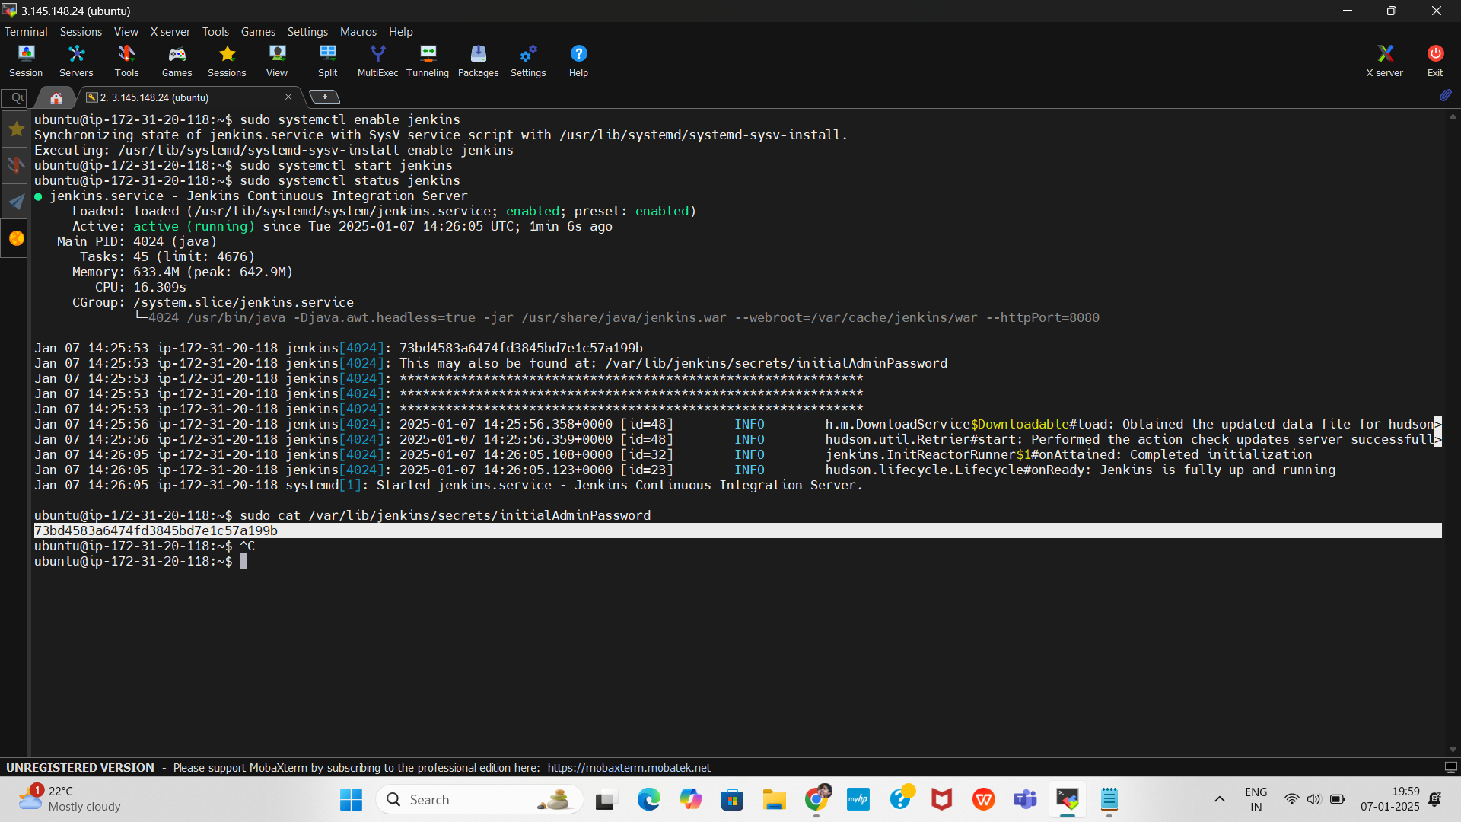
Unlock Jenkins
Run the following command on your EC2 instance to get the initial admin password:
Copy the password and paste it into the Jenkins web interface to unlock Jenkins.
sudo cat /var/lib/jenkins/secrets/initialAdminPassword

Slide 14
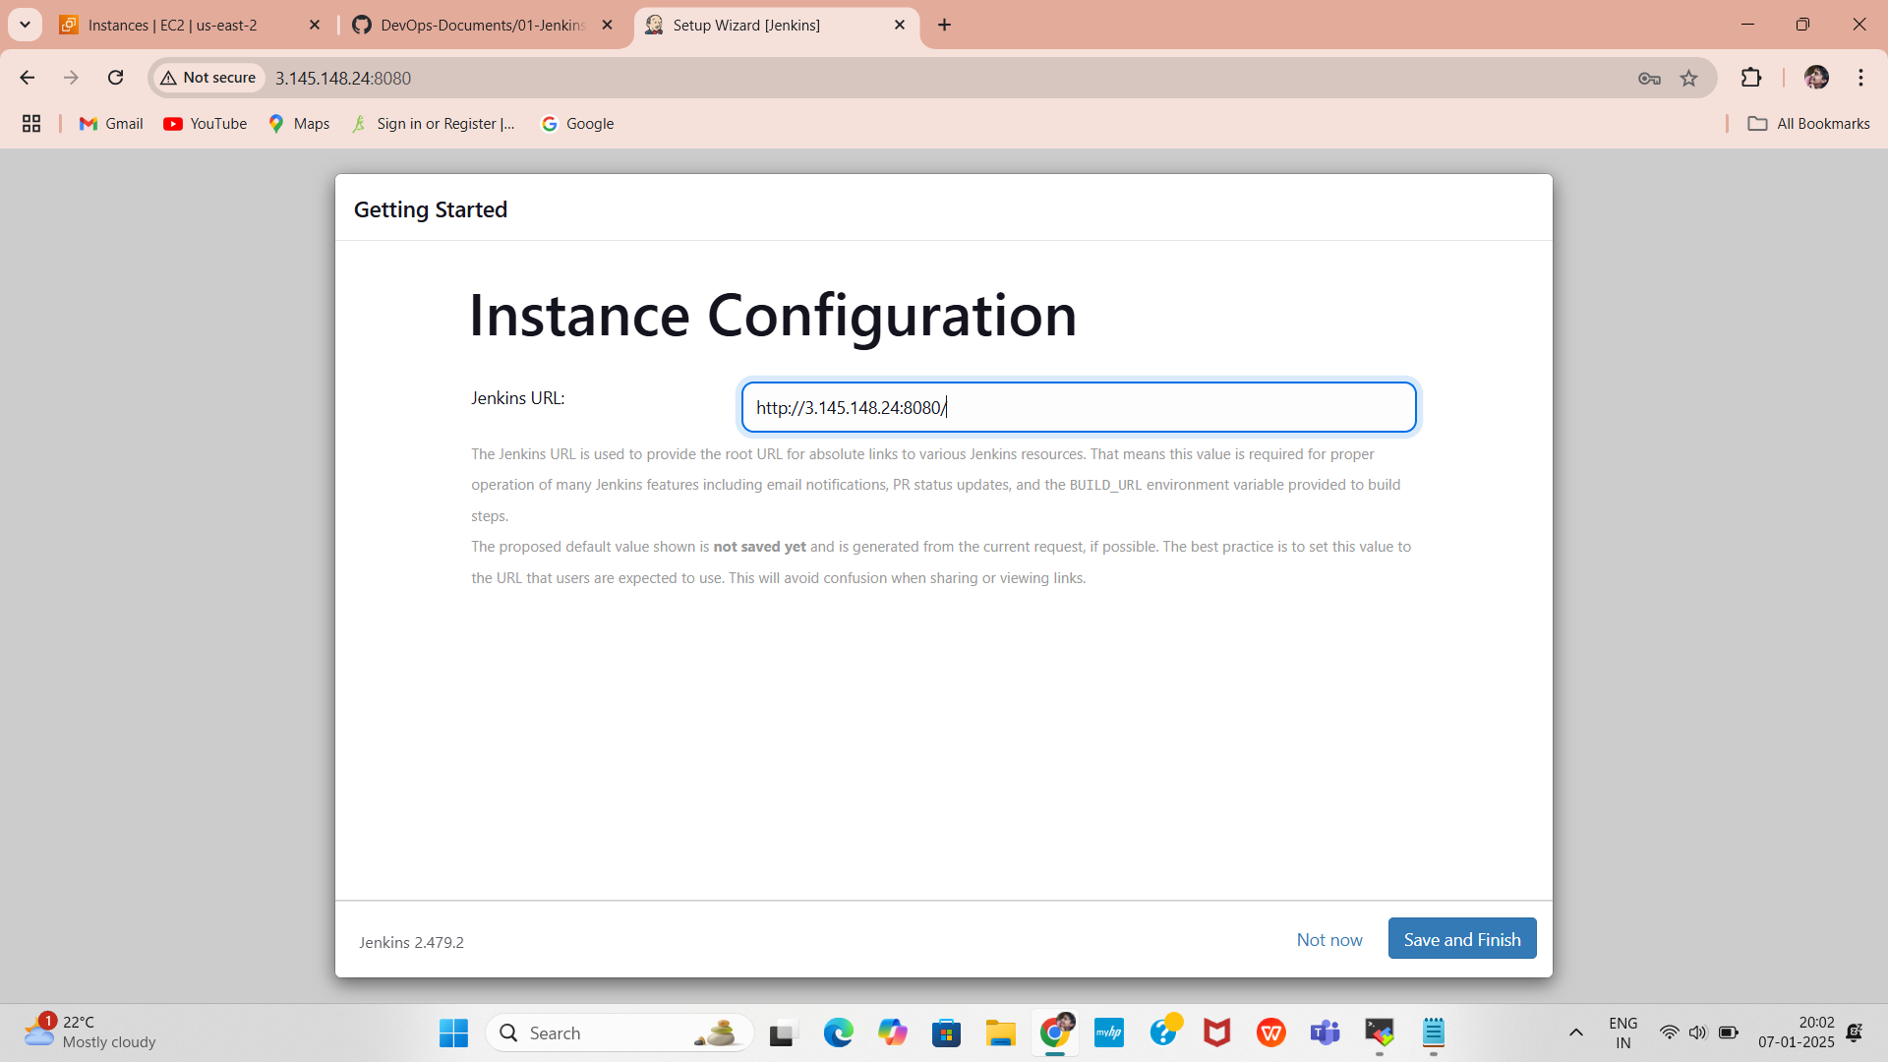
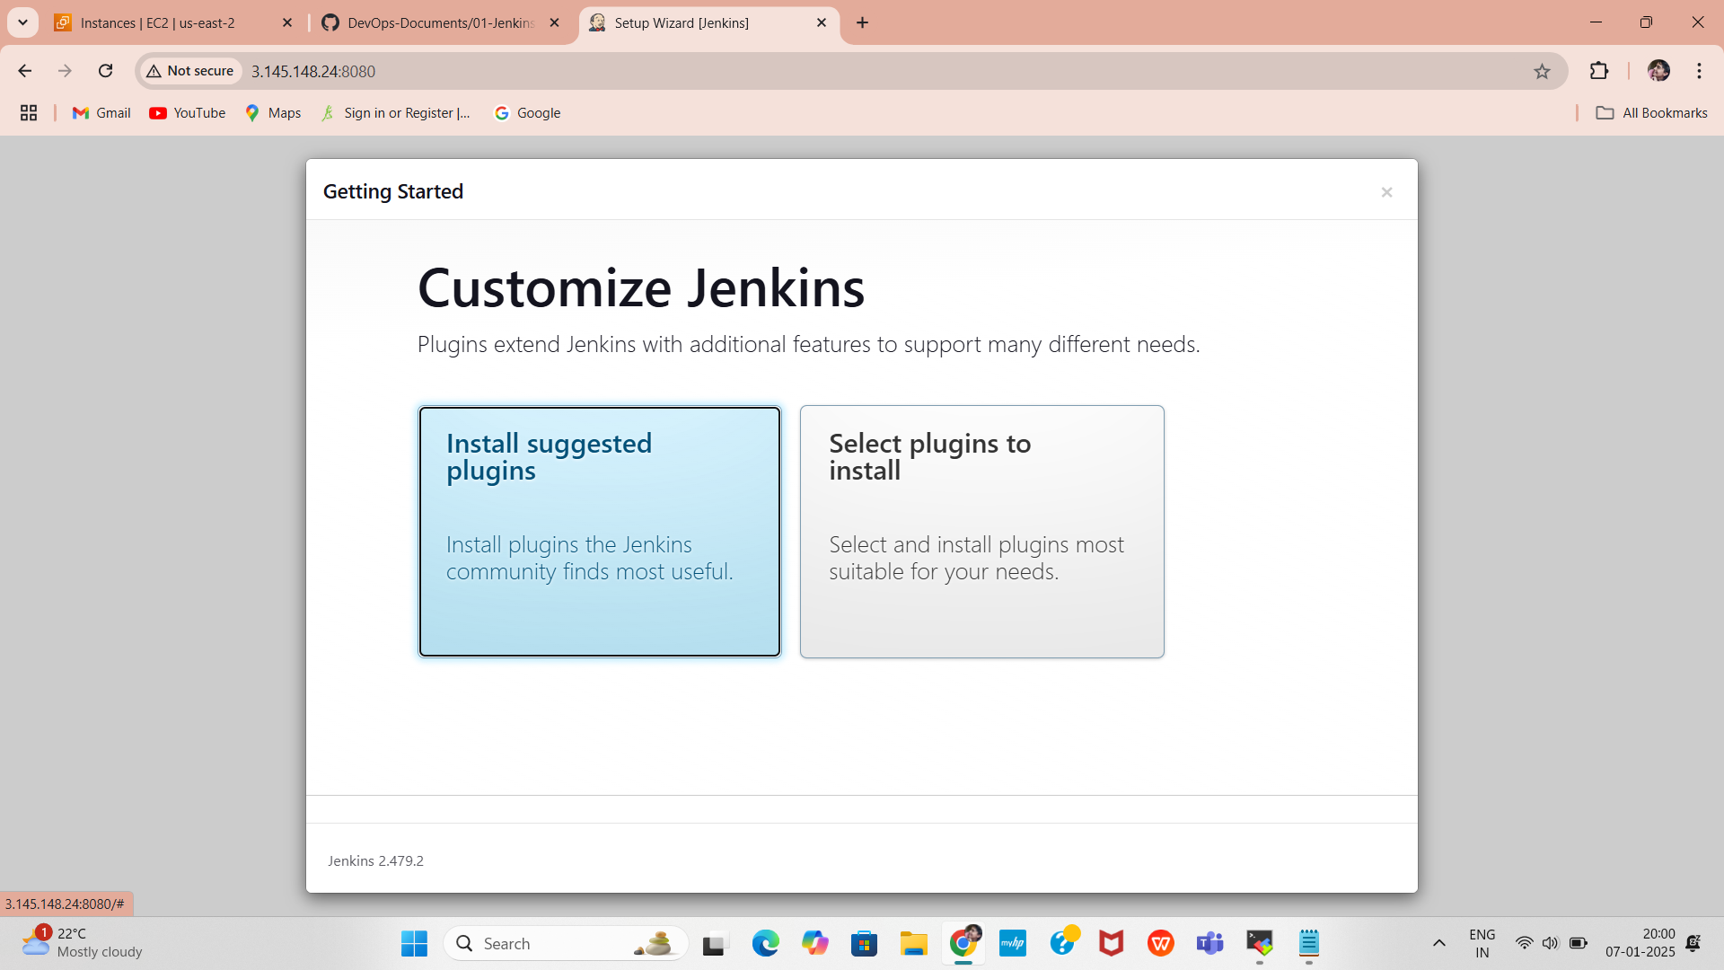
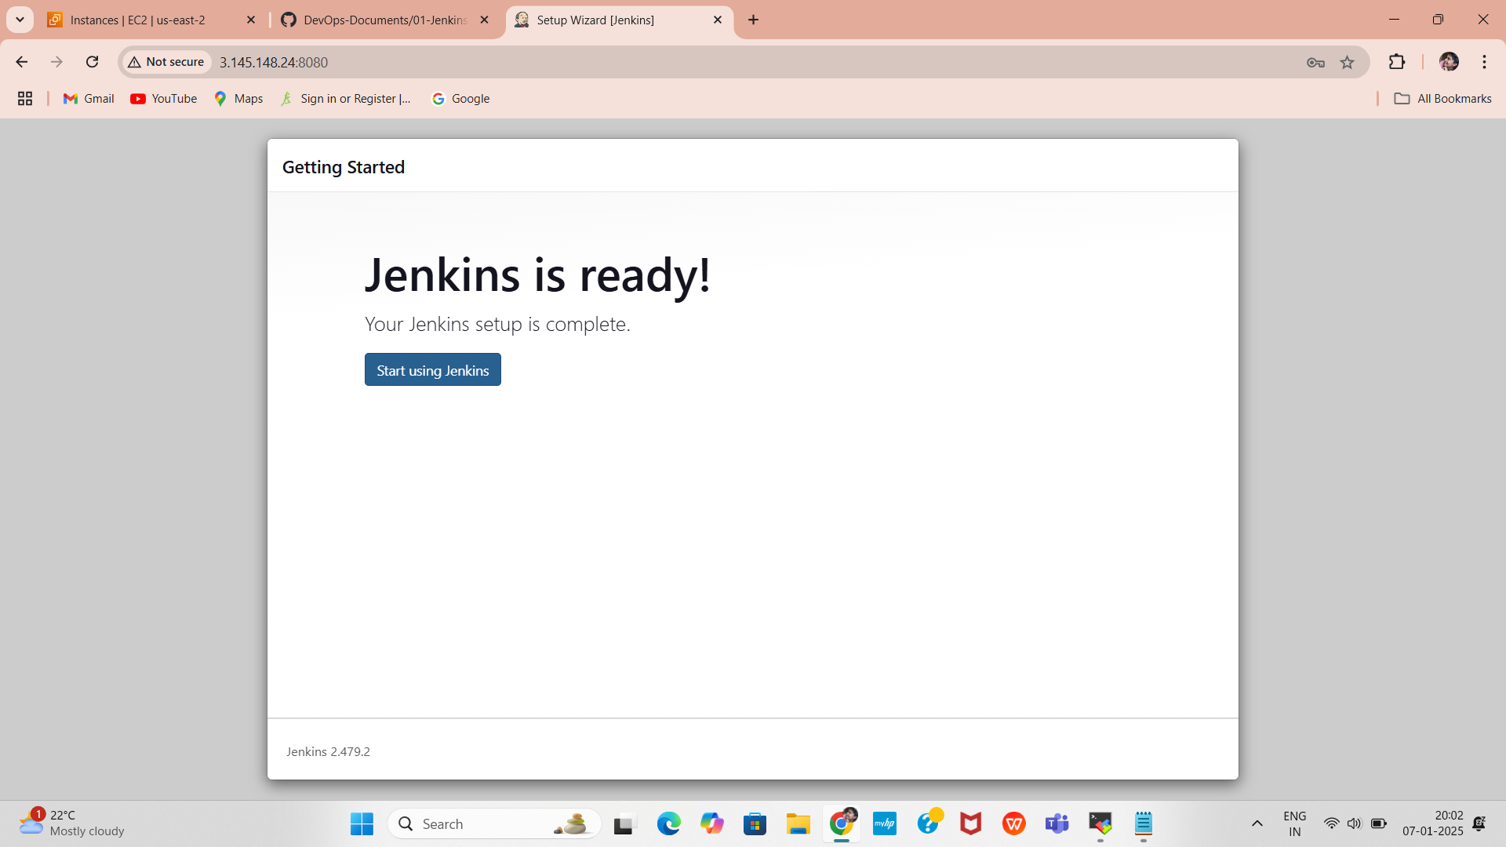
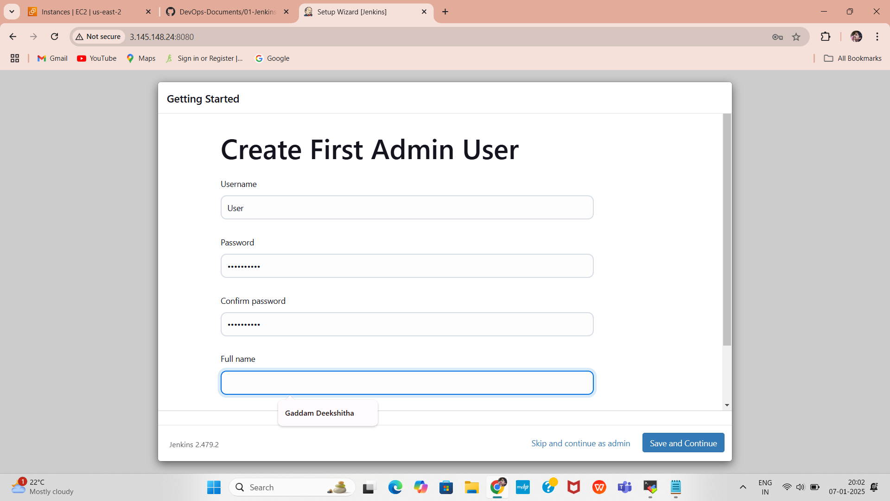
Complete Jenkins Setup
Install suggested plugins during the setup process.
Create an admin user account.
Complete the setup and start using Jenkins.

Slide 15
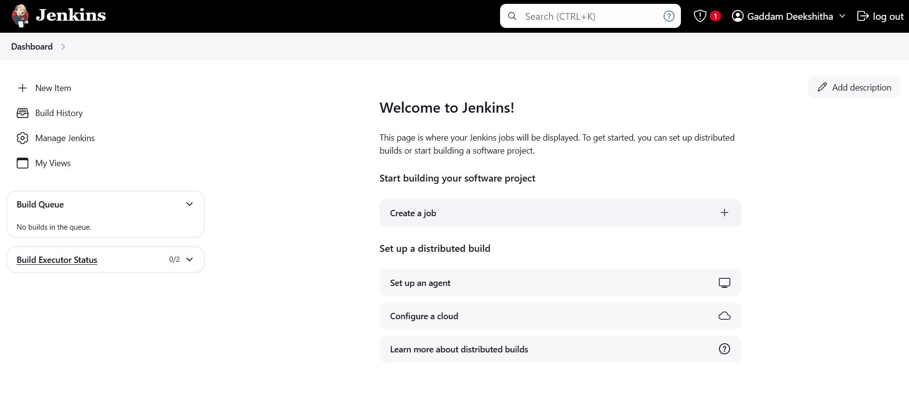
Jenkins Dashboard
After click on save and continue Jenkins dashboard page will open

Slide 16
Install Plugins in Jenkins:
In Jenkins, navigate to Manage Jenkins -> Available Plugins and install the following plugins:​
JDK (Eclipse Temurin Installer)​
SonarQube Scanner​
Maven​
OWASP Dependency Check​
pipeline stage view​
Docker​
Docker Commons​
Docker Pipeline​
Docker API​
docker-build-step​
Click install

Slide 17
Global Tools Configuration​
Go to Manage Jenkins → Tools → select as following images shown according versions​
Install JDK installtion ​
Maven installtion​
sonarqube scanner installtion​
Dpendency- check installtion and​ docker installtion then​ Click on Apply and Save​

Slide 18
Adding jdk tool in jenkins
Go to manage jenkins select tools click on add jdk
give name i have taken jdk17
enable install automatically scroll down select
install from adoptium.net
select version jdk-17-0.8.1+1

Slide 19
Adding maven tool in jenkins
Go to Manage Jenkins, select Tools, and click on Add Maven.
Give a name; for example, maven3.
Enable Install automatically, scroll down, and select Install from Apache.
Finally, choose the version mvn-3.6.0.

Slide 20
Adding Sonarqube scanner tool in jenkins
Go to Manage Jenkins, select Tools, and click on Add SonarQube Scanner Installation.
Give a name; for example, sonar-scanner.
Enable Install automatically, scroll down, and select Install from Maven Central.
Finally, choose the version SonarQube Scanner 5.0.1.3006.

Slide 21
Adding Dependency-check tool in jenkins
Go to Manage Jenkins, select Tools, and click on Add Dependency-Check Installation.
Give a name; for example, DP-Check.
Enable Install automatically, scroll down, and select Install from GitHub.com.
Finally, choose the version Dependency-Check 6.5.1.

Slide 22
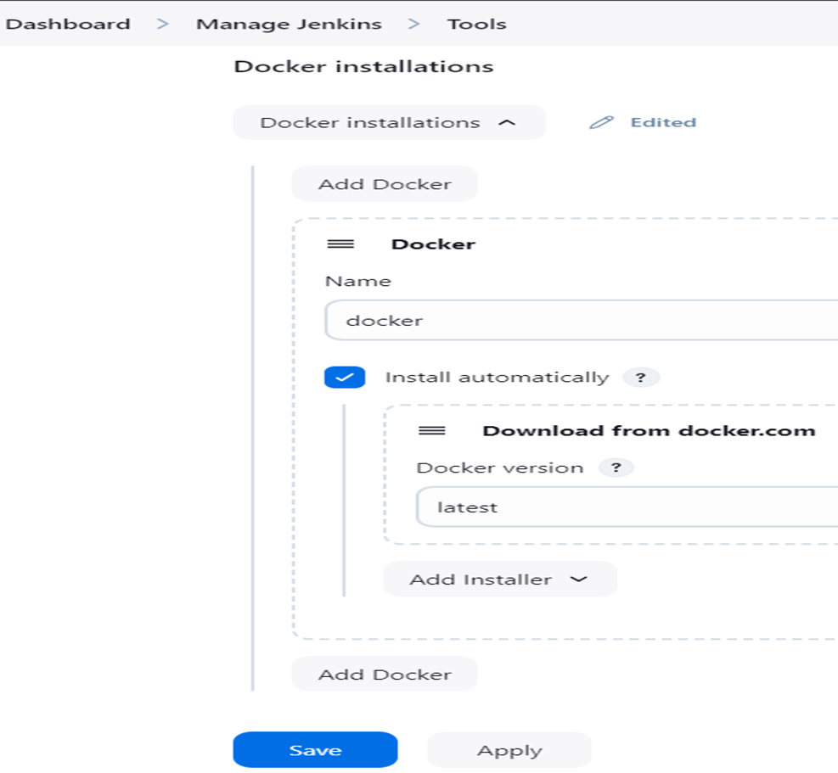
Adding docker tool in jenkins
Go to Manage Jenkins, select Tools, and click on Add Docker Installation.
Give a name; for example, docker.
Enable Install automatically, scroll down, and select Download from Docker.com.
Finally, choose the version latest.
Click on Apply & Save to ensure that all the above-added tools are saved.

Slide 23
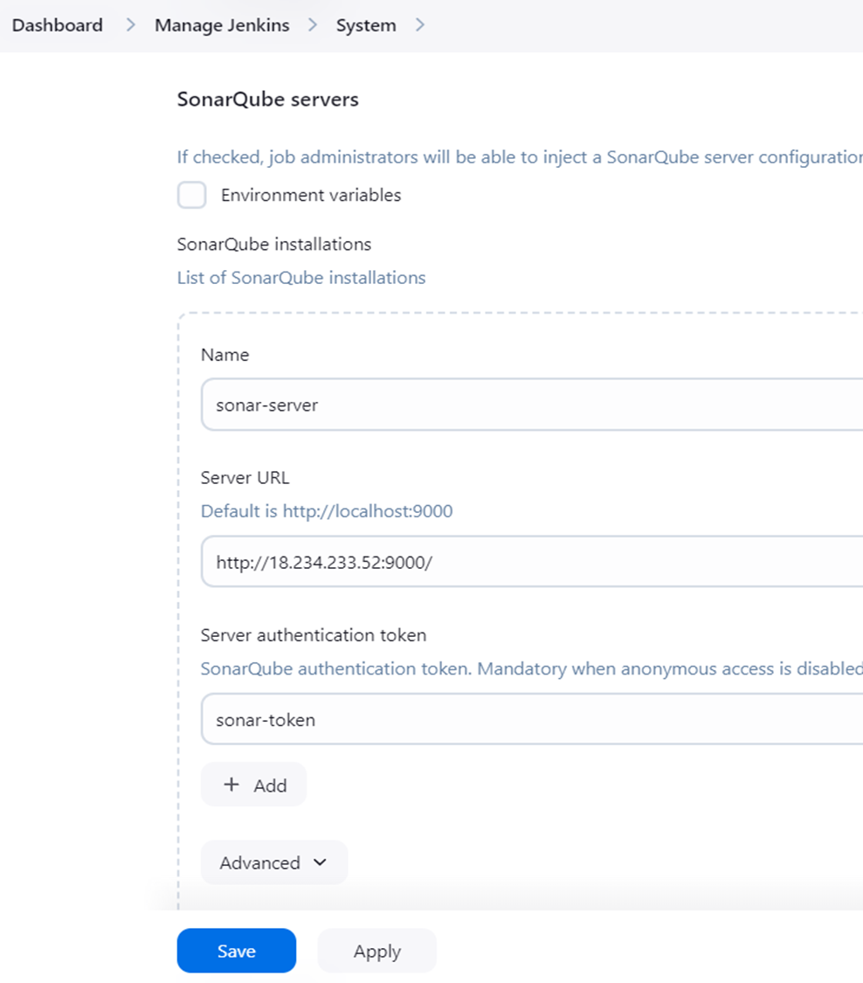
connecting sonarqube to jenkins
For connecting SonarQube in jenkins go to manage jenkins>system
give name sonar-server
give ec2 public ip adress:9000
select authentication token now select sonar-token created
then save and apply

Slide 24
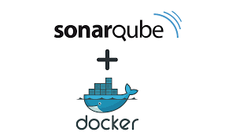
Introduction to Docker and SonarQube
Docker is a popular containerization platform that allows developers to package applications and their dependencies into a lightweight, portable container. These containers can run consistently across different environments, such as development, testing, and production.
With Docker, you can easily create a SonarQube instance by using a Docker image, eliminating the need for manual installation and configuration.
Using Docker to set up SonarQube simplifies the process by allowing you to:
Run SonarQube in a portable container without affecting your host system.
Easily manage dependencies and configurations.
Scale and manage the SonarQube instance more efficiently.
Quickly deploy SonarQube on any machine that supports Docker.

Slide 25

SonarQube is an open-source platform used to ensure code quality and code security by continuously analyzing source code. It helps developers identify issues, vulnerabilities, and bugs early in the development lifecycle, making it easier to maintain clean, secure, and maintainable code.
Improves Code Quality: Ensures clean, maintainable, and efficient code.
Enhances Security: Detects security vulnerabilities early in the development process.
Automates Code Reviews: Reduces manual effort by automating code analysis and providing actionable insights.
Integrates with Development Tools: Works with popular tools and platforms to fit seamlessly into existing workflows.
Supports DevOps Practices: Ensures that code quality checks are part of the DevOps pipeline.

Slide 26
Installing Docker and Running SonarQube in a Docker Container
Need to install Docker on an Ubuntu-based EC2 instance and run SonarQube using a Docker container.
First, update the existing packages on your EC2 instance and Install Docker
After Installing the docker create user in usermod by using sudo usermod -aG docker $USER #my case is ubuntu
Then New group for docker by using newgrp docker
sudo apt update
curl -fsSL get.docker.com | /bin/bash
sudo usermod -aG docker ubuntu
exit
Check if Docker is successfully installed by running
You should see the Docker version displayed in the terminal.
docker -v

Slide 27
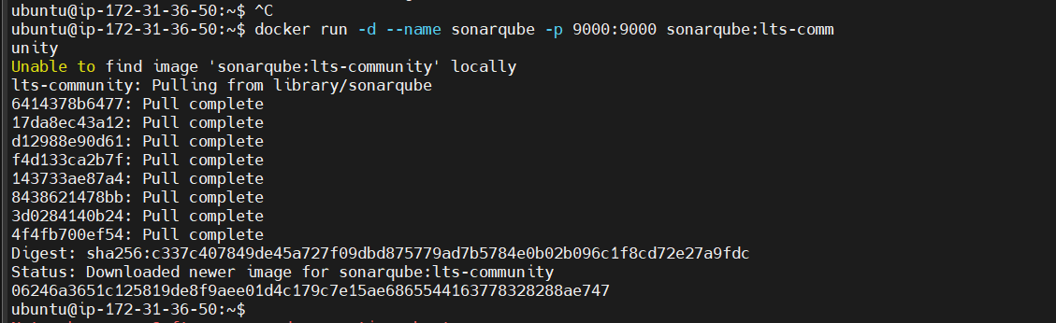
After the docker installation, we create a sonarqube container by using :
Then connect the SonarQube by using Instance public IPV4address:9000 (3.145.148.24:9000) (SonarQube default port number)
docker run -d --name sonar -p 9000:9000 sonarqube:lts-community

Slide 28
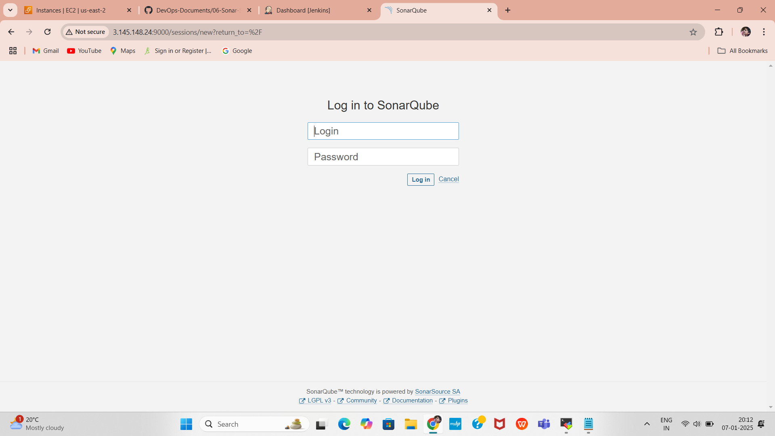
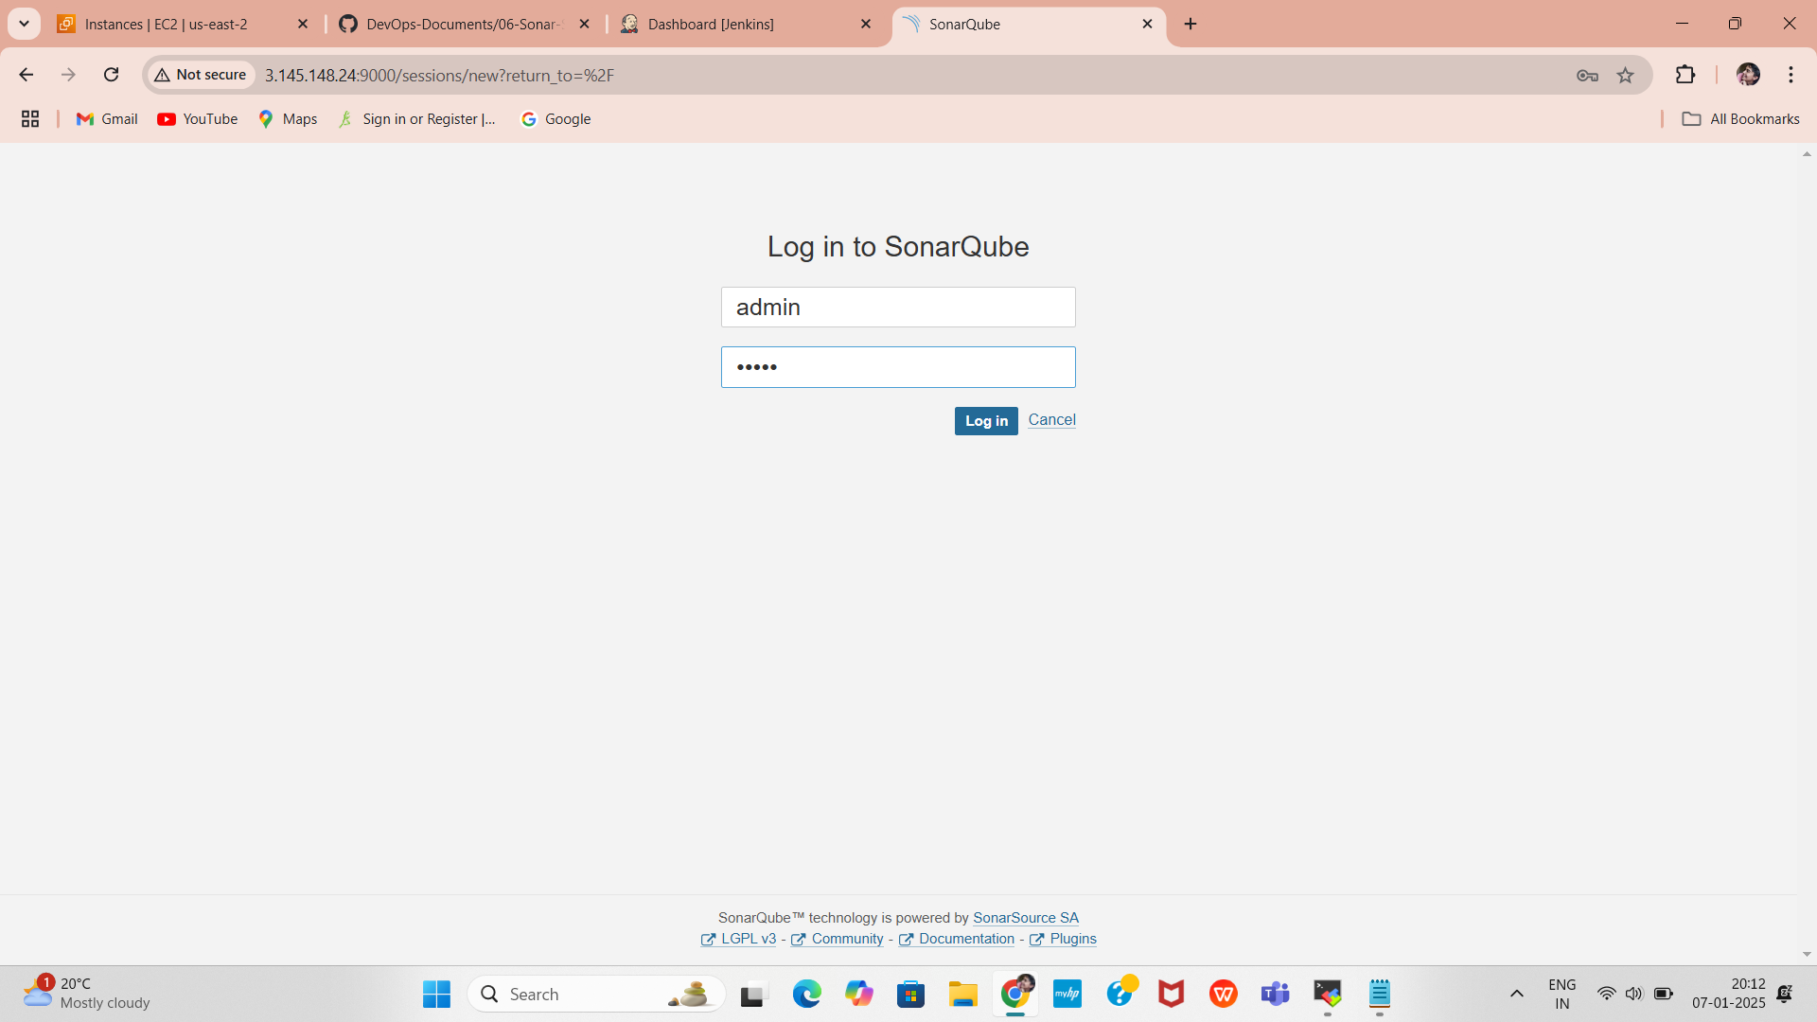
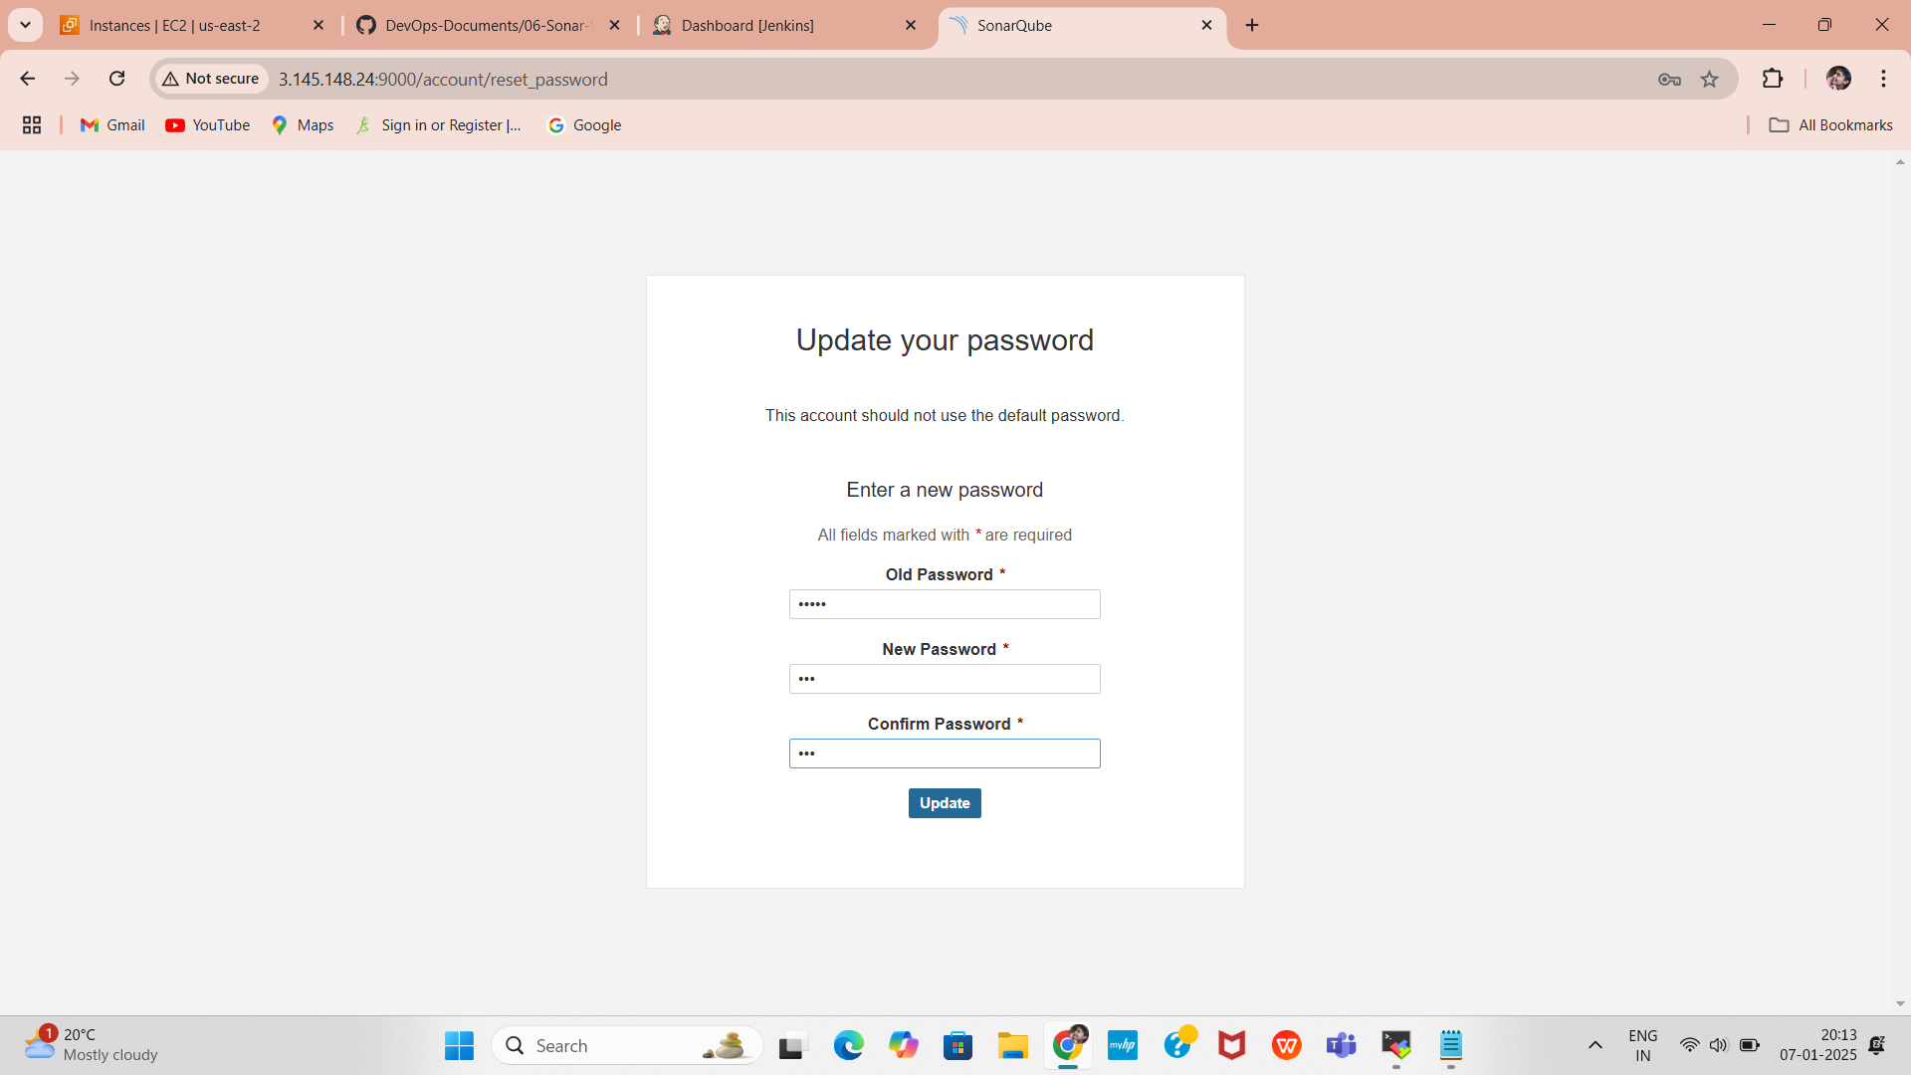
Open Web Chrome Port 9000
SonarQube runs on port 9000 . Ensure that port 9000 is open in your security group and allow it through the Ubuntu firewall.
Access sonarqube Web Interface, Open your browser and go to http://3.145.148.24:9000
Use the default credentials to log in (if not modified):
Username: admin
Password: admin
Change Default Password:
After the first login, you will be prompted to change the password.

Slide 29
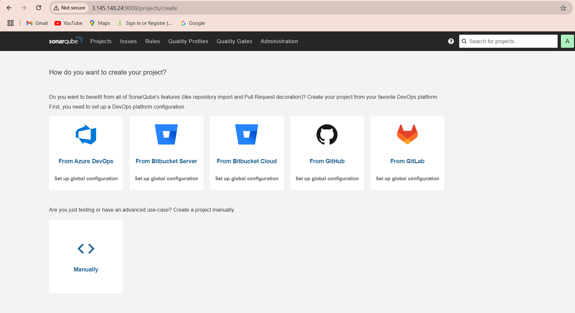
SonarQube Dashboard
After click on Login and continue Sonarqube dashboard page will open

Slide 30
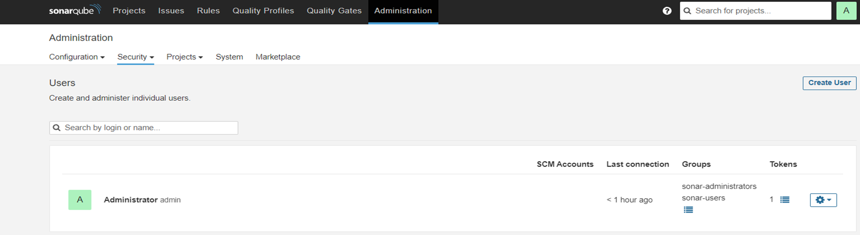
Token creation follow below steps

Slide 31
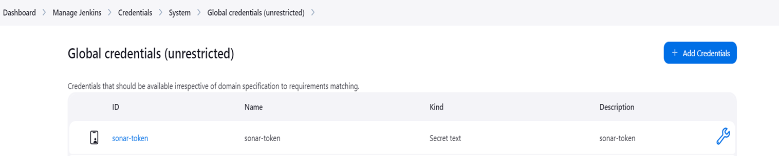
Give a name, click on Generate, and copy the code.
Go to manage jenkins click add credentials
kind > select secret text , ID > sonar-token
create one more for docker hub
give Docker Hub >username & password
Connecting sonar-token in jenkins

Slide 32
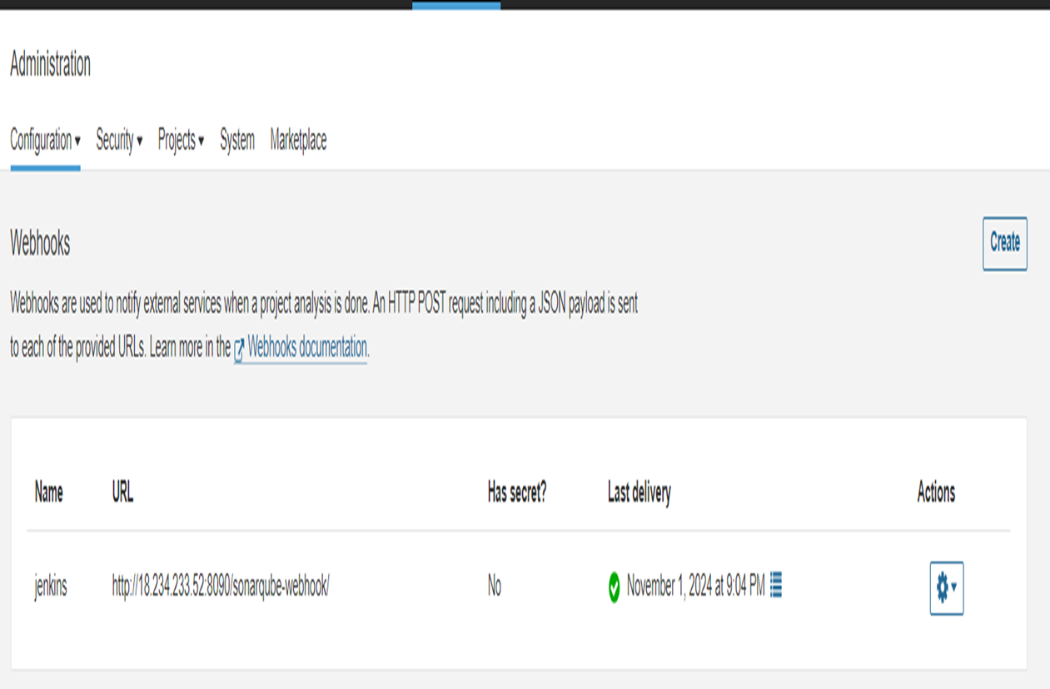
Connecting jenkins in sonarqube
As show in slide got to Administration select configuration > select webhook
connecting jenkins in sonarqube(webhook)
Click on Create and add the details.
Set the Name as jenkins.
In the URL section of the Quality Gate, enter: http://jenkins-public-ip:8090/sonarqube-webhook/
Leave the Secret box blank.
Finally, click on Create.

Slide 33
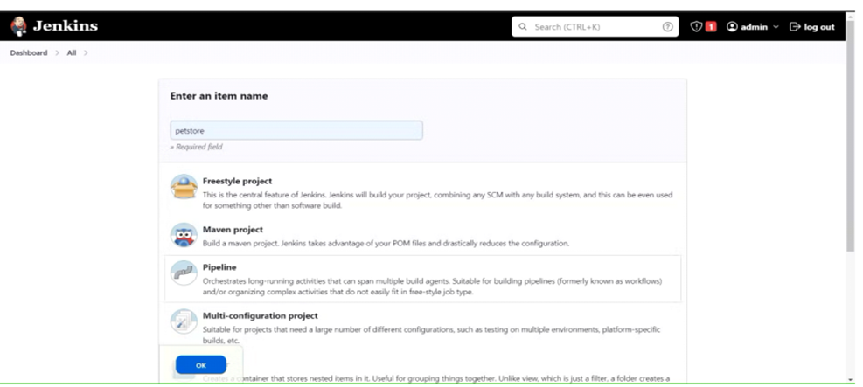
Create a New Job with a Pipeline option:
create new job give name of job
Select pipline & click ok
click pipline script>it’ll scroll down then give code
click apply &save
It’ll redirect to another page click Build now
go to console output for checking out put

Slide 34
Mvn test code
Pipeline script:
pipeline{
agent any
tools {
jdk 'jdk17'
maven 'maven3'
}
stages{
stage ('clean Workspace'){
steps{
cleanWs()
}
}
stage ('checkout scm') {
steps {
git 'https://github.com/Harshit-cyber-bit/jpetstore-6'
}
}
stage ('maven compile') {
steps {
sh 'mvn clean compile'
}
}
stage ('maven Test') {
steps {
sh 'mvn test'
}
}
}
}

Slide 35
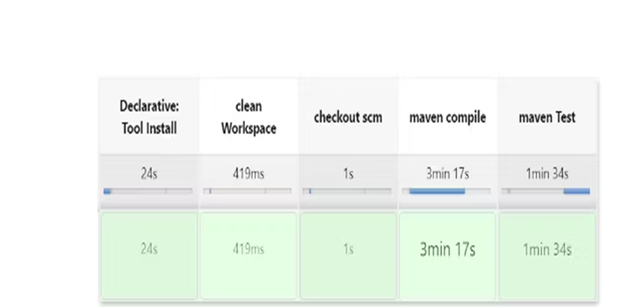
Stage view output

Slide 36
Configure SonarQube Server in Jenkins
Now add this script in pipeline (Dashboard→ petstore→ configuration) and test the steps of SonarQube which we did:
#under tools section add this environment.
Apply, save and build now
environment {
SCANNER_HOME=tool 'sonar-scanner'
}
# in stages add this
stage("Sonarqube Analysis "){
steps
{
withSonarQubeEnv('sonar-server’) {
sh ''' $SCANNER_HOME/bin/sonar-scanner -Dsonar.projectName=Petshop \
-Dsonar.java.binaries=. \
-Dsonar.projectKey=Petshop '''
}
}
}
stage("quality gate"){
steps
{
script {
waitForQualityGate abortPipeline: false, credentialsId: 'Sonar-token'
}
}
}

Slide 37
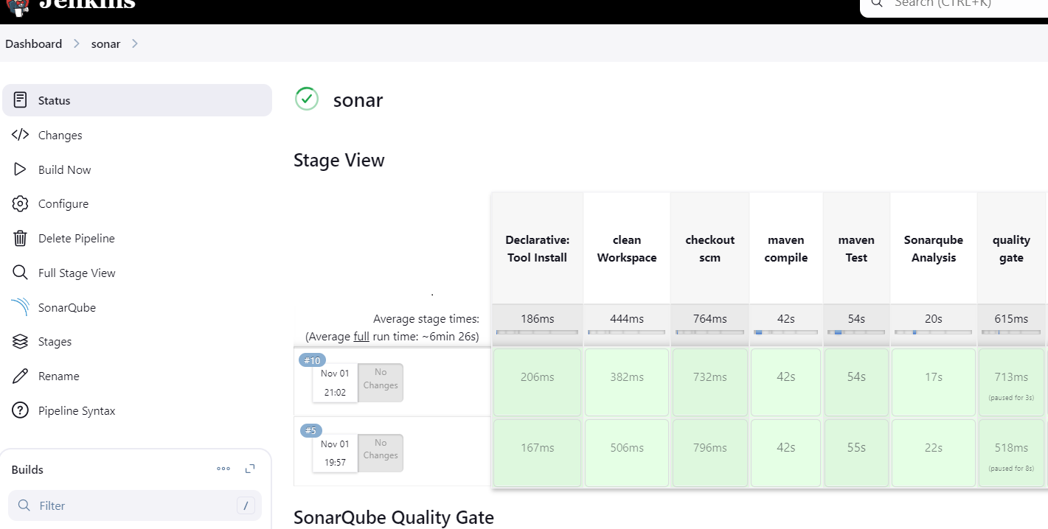
stage view

Slide 38
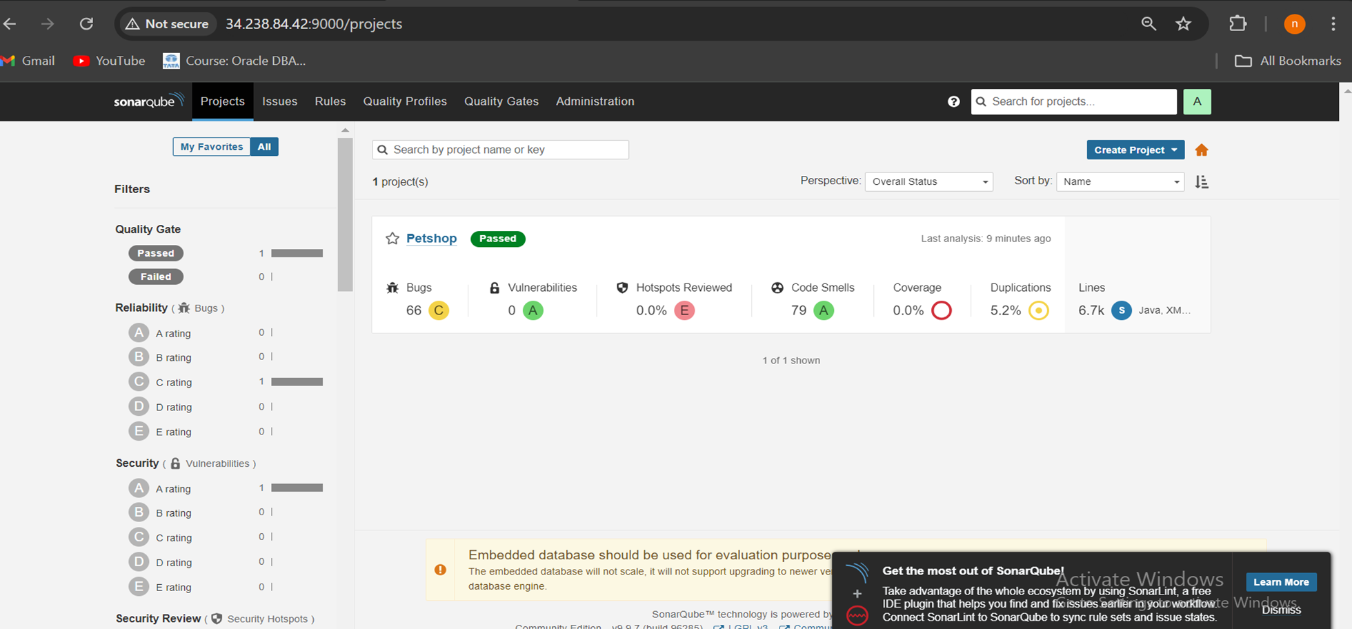
SonarQube result

Slide 39
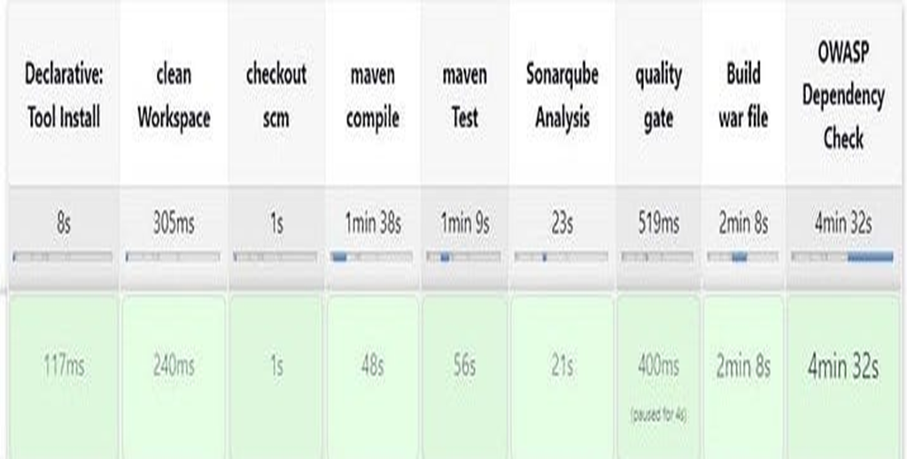
Add the script of OWASP in pipeline now:
stage ('Build war file'){
steps{
sh 'mvn clean install -DskipTests=true'
} }
stage("OWASP Dependency Check"){
steps{
dependencyCheck additionalArguments: '--scan ./ --format XML ', odcInstallation: 'DP-Check'
dependencyCheckPublisher pattern: '**/dependency-check-report.xml'
} }

Slide 40
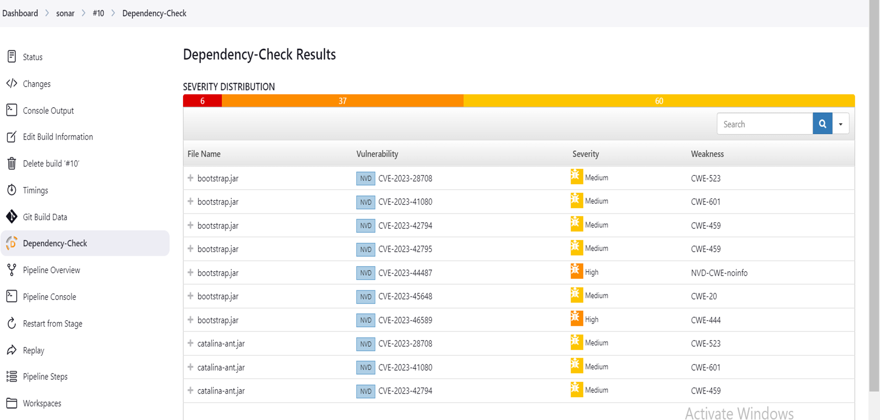
Dependency Check :
Scans project dependencies for known vulnerabilities.
Identifies outdated libraries that may introduce security risks.

Slide 41
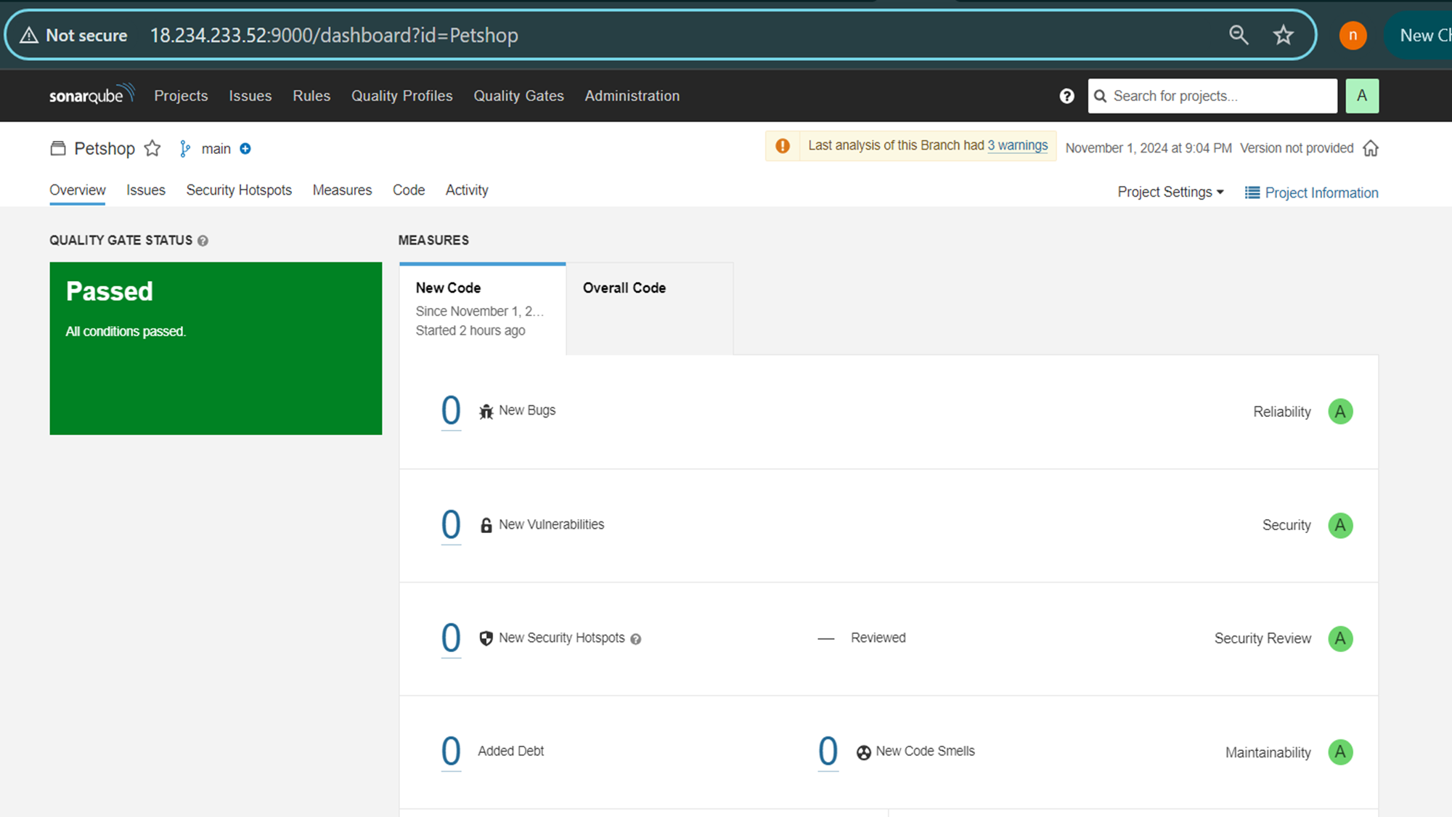
Quality Gate Status

Slide 42
Include this stage in the pipeline to build the Docker image, push it to Docker Hub, and run the container
stage ('Docker Login'){
steps {
withCredentials([usernamePassword(credentialsId: 'docker', passwordVariable: 'mypasswd', usernameVariable: 'usr')]) {
sh "docker logout"
sh "echo ${mypasswd} | docker login -u ${usr} --password-stdin"
} } }
stage ('Built Docker') {
steps {
sh "docker build -t deekshitha763/petshop:latest ."
} }
stage ('Push to dockerhub') {
steps {
sh "docker push deekshitha763/petshop:latest"
} }
stage ('Deploy to container') {
steps {
sh 'docker run -d --name pet1 -p 8080:8080 deekshitha763/petshop:latest'
}
}
}
}
}

Slide 43
Entire full code
pipeline{
agent any
tools {
jdk 'jdk17'
maven 'maven3'
} environment {
SCANNER_HOME=tool 'sonar-scanner'
} stages{
stage ('clean Workspace'){
steps{
cleanWs() } }
stage ('checkout scm') {
steps { git 'https://github.com/Harshit-cyber-bit/jpetstore-6' } }
stage ('maven compile') {
steps {
sh 'mvn clean compile'
} }
stage ('maven Test') {
steps {
sh 'mvn test' } }
stage("Sonarqube Analysis "){
steps{
withSonarQubeEnv('sonar-server') {
sh ''' $SCANNER_HOME/bin/sonar-scanner -Dsonar.projectName=Petshop \
-Dsonar.java.binaries=. \
-Dsonar.projectKey=Petshop '''
} } }
stage("quality gate"){
steps {
script {
waitForQualityGate abortPipeline: false, credentialsId: 'Sonar-token'
} } }
stage ('Build war file') {
steps{
sh 'mvn clean install -DskipTests=true'
} }
stage("OWASP Dependency Check") {
steps{
dependencyCheck additionalArguments: '--scan ./ --format XML ', odcInstallation: 'DP-Check’
dependencyCheckPublisher pattern: '**/dependency-check-report.xml' } }
stage ('Docker Login'){
steps {
withCredentials([usernamePassword(credentialsId: 'docker', passwordVariable: 'mypasswd', usernameVariable: 'usr')]) {
sh "docker logout"
sh "echo ${mypasswd} | docker login -u ${usr} --password-stdin"
} } }
stage ('Built Docker') {
steps {
sh "docker build -t deekshitha763/petshop:latest ."
} }
stage ('Push to dockerhub') {
steps {
sh "docker push deekshitha763/petshop:latest"
} }
stage ('Deploy to container') {
steps {
sh 'docker run -d --name pet1 -p 8080:8080 deekshitha763/petshop:latest'
} } } } }

Slide 44
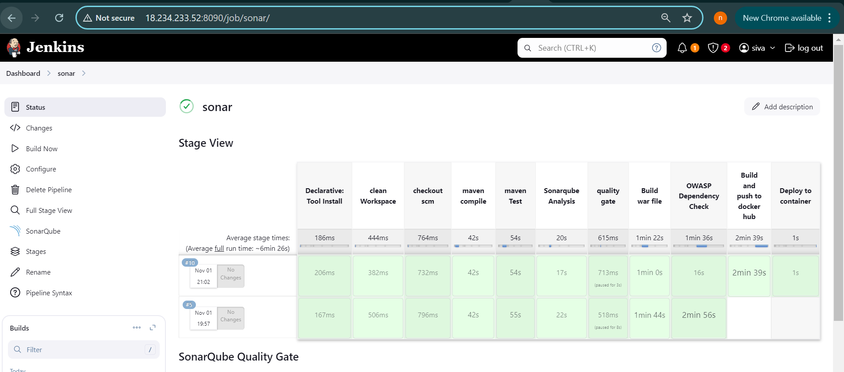

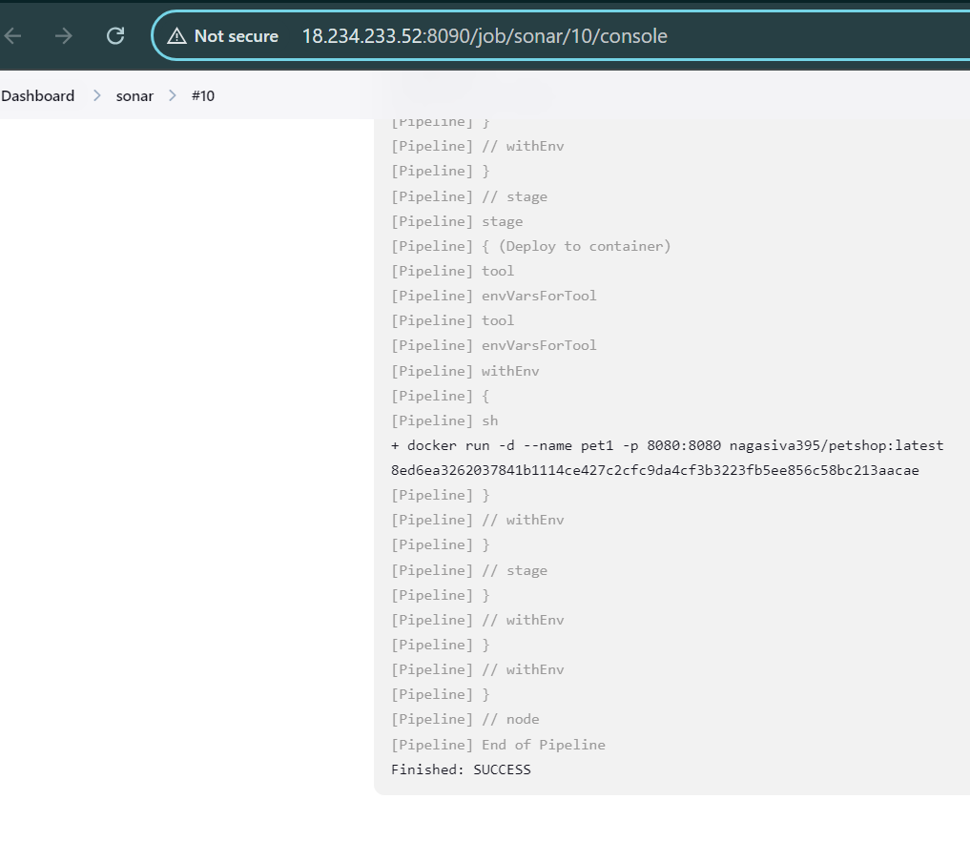
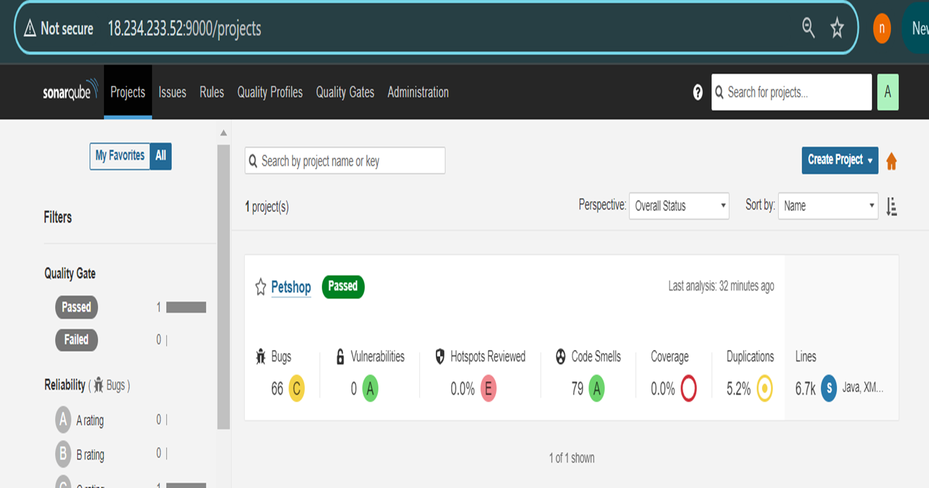
Sonar Stage View:
SonarQube result:
console output:

Slide 45
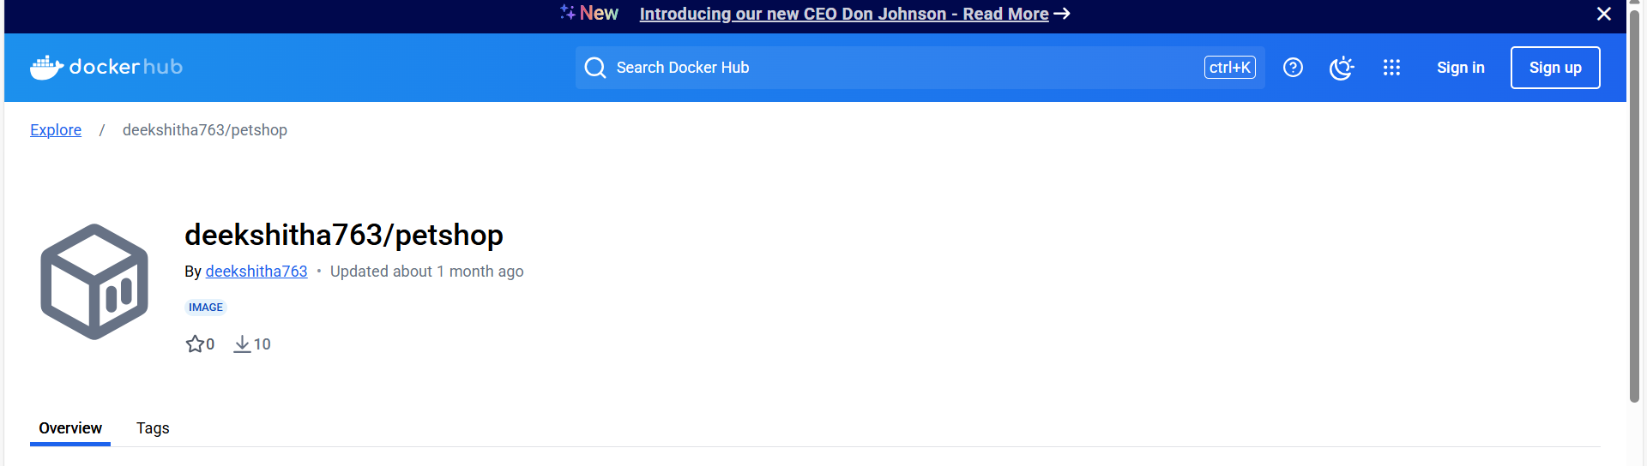
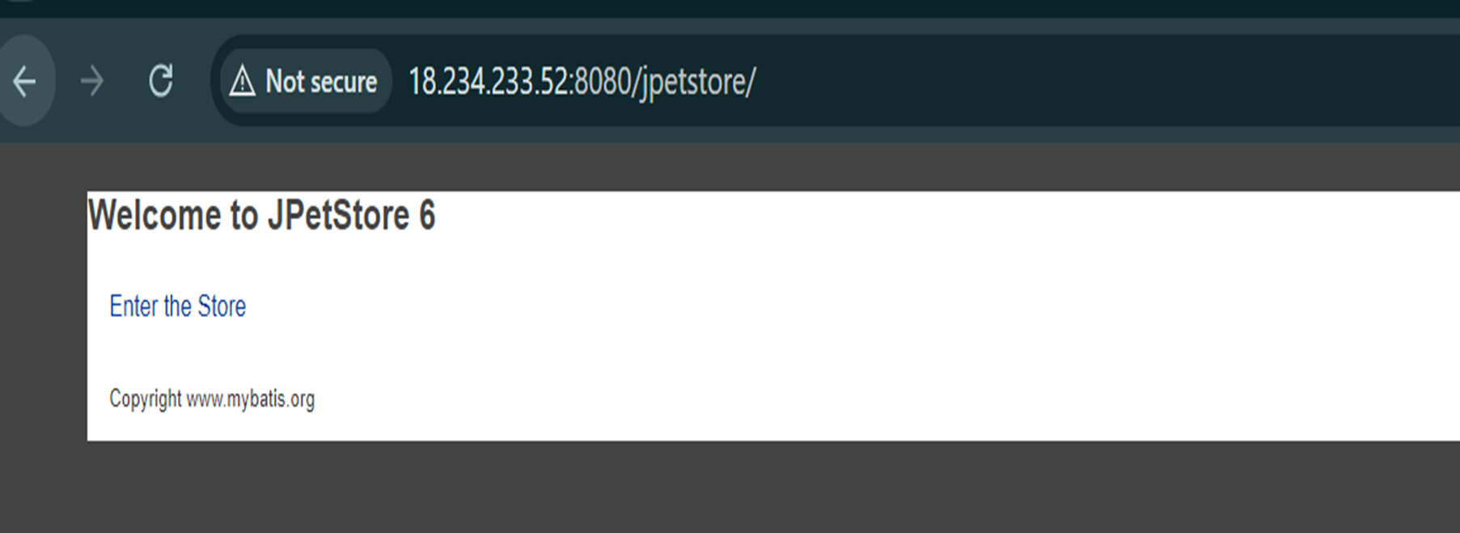
Pushed to docker hub
Now after build process of the pipeline you would be able to see the result of web application by visiting the below url:
<jenkins-ip:8080>/jpetstore
click Enter the store to see result

Slide 46
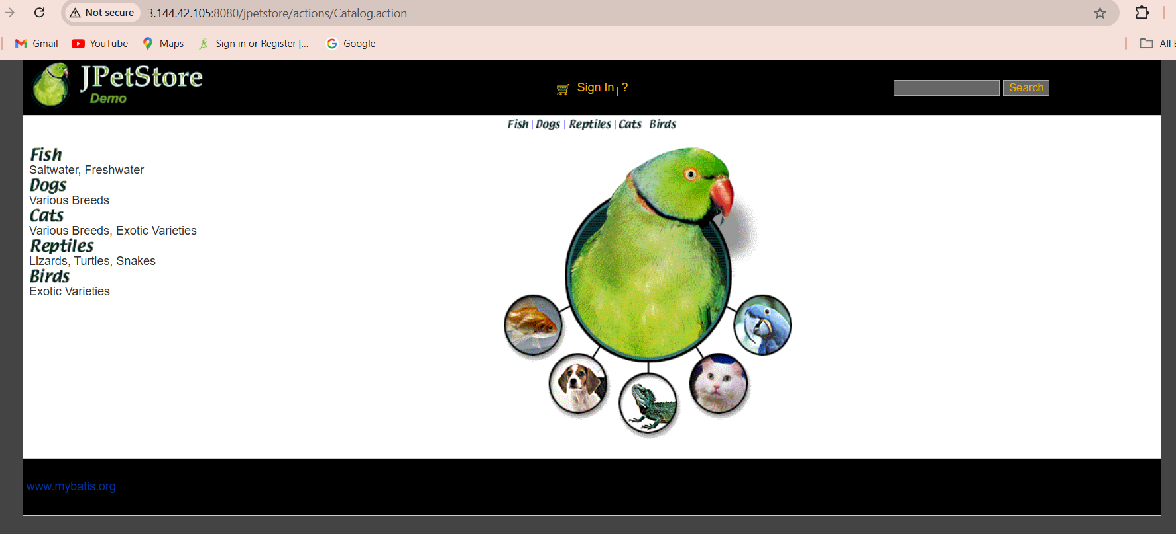
This is the web application we have build

Slide 47
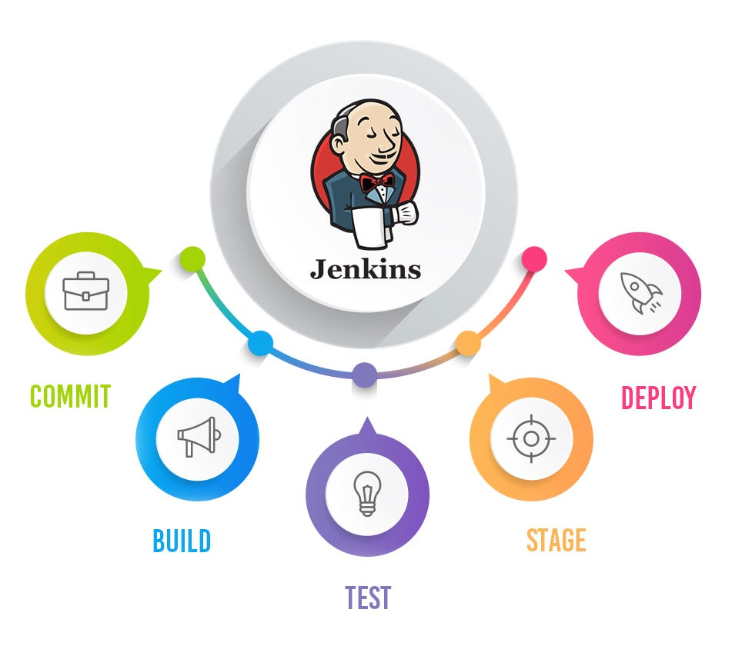
conclusion
This CI/CD pipeline plays a crucial role in ensuring the robustness, security, and scalability of the Petshop Java-Based Application.
By automating the entire development and deployment process:
The application remains in a deployable state at all times.
Code quality is consistently maintained through automated checks.
Security vulnerabilities are identified early and mitigated effectively.
Deployment is streamlined and efficient, reducing manual errors and downtime.
Overall, this approach enhances the reliability and performance of the application throughout its lifecycle.

Slide 48
Thank you
G.DEEKSHITHA

